Slide 1
A Winning Approach to
Professional Relationships

Slide 2
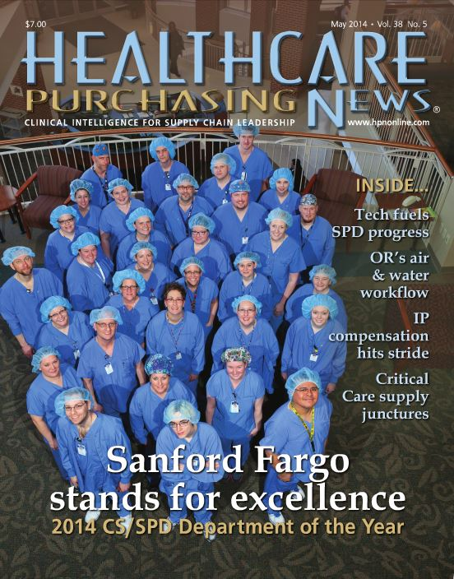
A LITTLE ABOUT ME…
Healthcare Purchasing News 2014 CS/SPD Department of the Year (Sanford Fargo SPD)
IAHCSMM member, CRCST & CHL certifications
Prairie Pioneers (North Dakota chapter) Vice President, 2015 - present
IAHCSMM nominating committee, 2016
AAMI ST79 – Steam Sterilization Practices working group – 2016 - present
AHRMM member

Slide 3
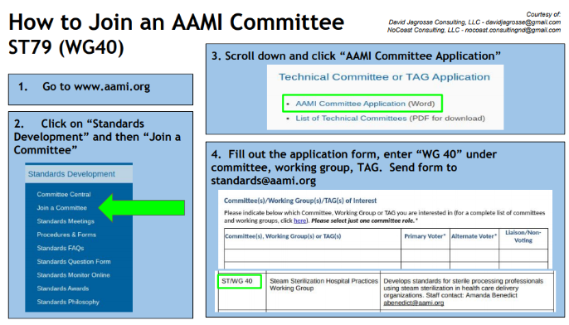

Slide 4
What is your “WHY”?
Why are you sitting here today?

Slide 5
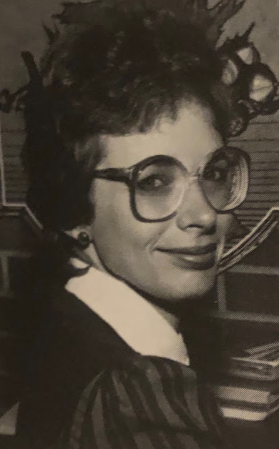
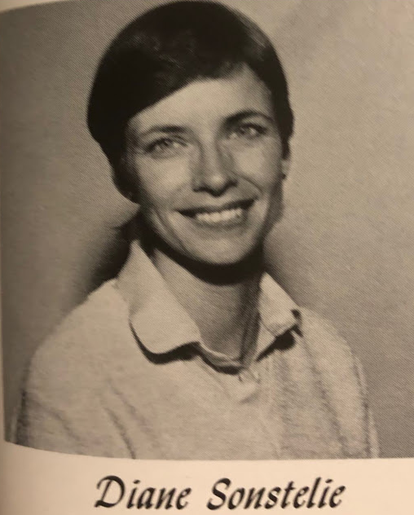
40+ Years!!!

Slide 6
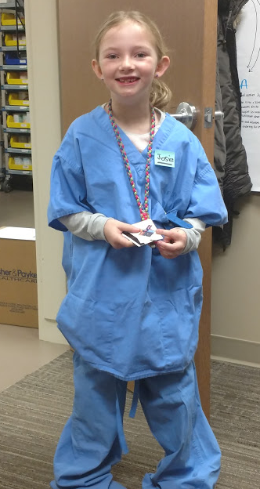
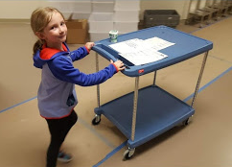

Slide 7
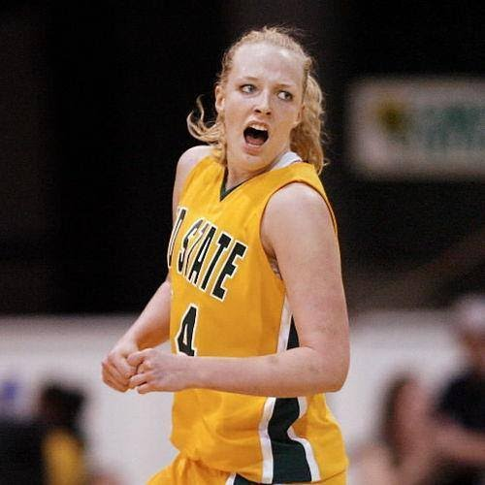

Slide 8
SANFORD MEDICAL CENTER FARGO
Level 1 Trauma Center
28 Operating Rooms
384 beds
1,000,000 square feet
181 inventory locations, 3 on-site warehouses
$494 million

Slide 9
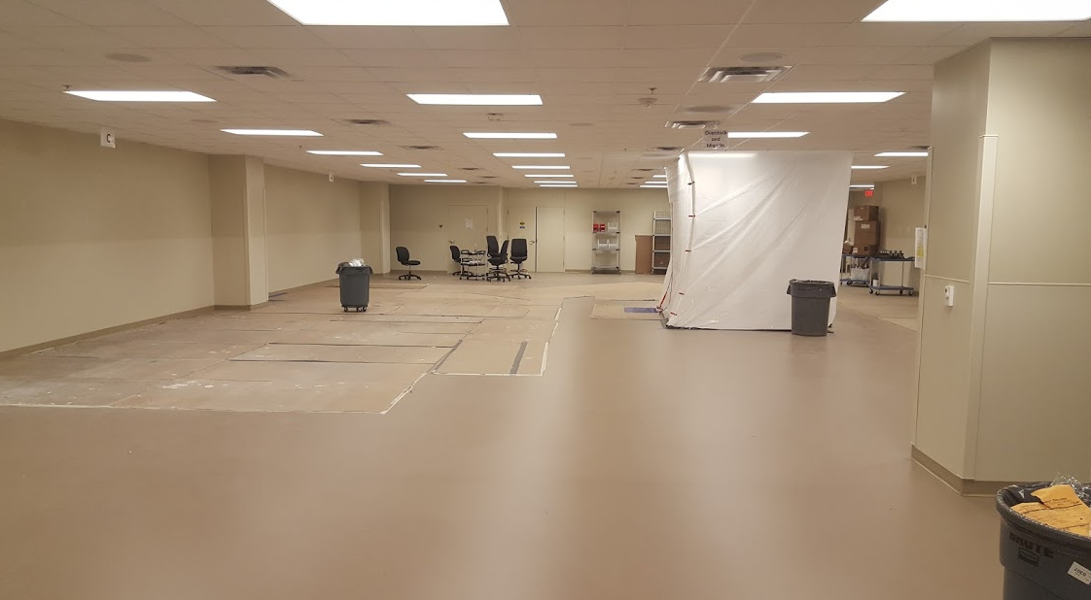

Slide 10
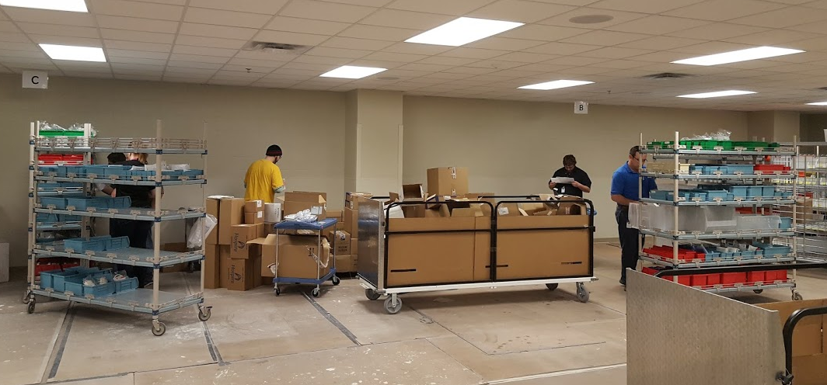

Slide 11
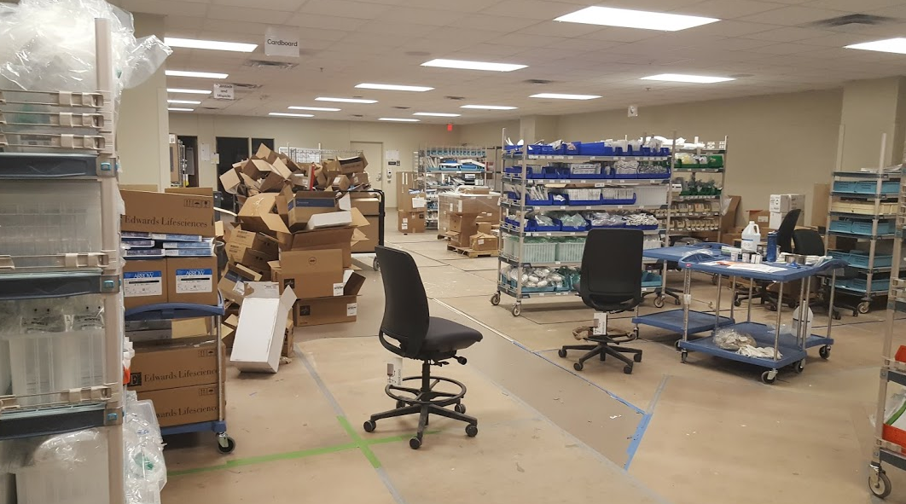

Slide 12
OBJECTIVES
Discuss tools for improving your relationship with the OR and other customers
Define service level agreements.
Discuss scripting for improved communication.
Describe rounding techniques.

Slide 13
THINGS TO THINK ABOUT…
It’s all about perception! These are PR tools.
Would they choose your department if they could “shop around?”
How can you elevate the professionalism in your department?
Why should you do this???
Protect your department, peace of mind
Tool to showcase success

Slide 14
Ultimately…
You won’t have to rely on alternative methods

Slide 15
SERVICE AGREEMENTS

Slide 16
SERVICE AGREEMENT GOALS
Provides clear expectations for your department
Drives work and initiatives
Foundation for service

Slide 17
INVOLVING STAKEHOLDERS
Approach depends on reporting structure and relationship
Need input from both groups:
Sterile Processing
What are you providing to the customer? - VALUE
Customer
What do you need from the customer?
Should tie back to your service

Slide 18
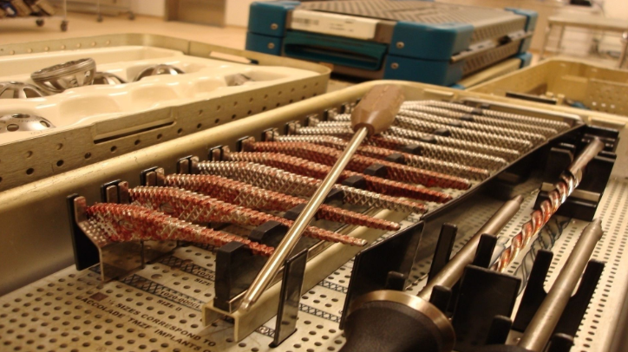

Slide 19
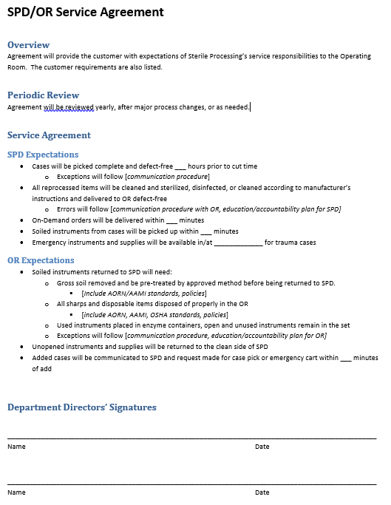
KEY COMPONENTS
Overview
Periodic Review
Agreement Details
Signature
Yes, both of you need
to sign!

Slide 20
OVERVIEW
Quick summary or intro
State intent

Slide 21
PERIODIC REVIEW
Provides timeline of when the agreement will be reviewed and/or updated

Slide 22
SERVICE AGREEMENT
The meat of the document
SPD Expectations
What is important to the customer?
All value-added service

Slide 23
Keep it realistic
Don’t make promises you can’t keep!
Base it on performance indicators
Should be easy to report
Automated is best, avoid manual documentation if possible

Slide 24
When things go wrong...
Build into document
Communication plan
How errors are documented
Accountability action plans

Slide 25
SERVICE AGREEMENT

Slide 26
SERVICE AGREEMENT
OR/Customer Expectations
What do you need from them to do your job properly and efficiently?
This is your time to state what you need
If you have resources available, offer to help make educational materials

Slide 27
What are your current pain points?
Cite AAMI, AORN, OSHA, hospital policies or work with Infection Control - Will give you additional traction

Slide 28
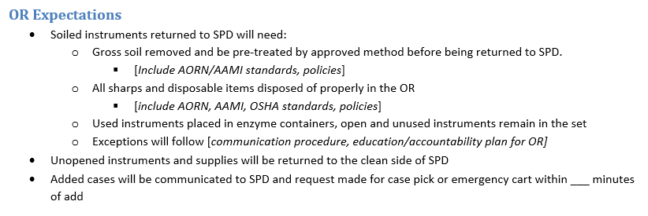
SERVICE AGREEMENT

Slide 29
IMPLEMENTATION PLANNING
Involve Stakeholders
Determine governance
How are you tracking success and deviation and sharing information?
Agree on an implementation date
Share plans with your leadership and front line staff
Sign and implement!

Slide 30
SCRIPTING

Slide 31
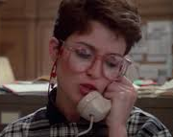
WHEN THE OR CALLS
First impression of the department
Can establish or strengthen trust in department or cause unease
Can be used for front line staff answering the phone, working at a window, managing turnover/priority items, decontam

Slide 32
SCRIPT GOALS
Interactions are usually quick
How can you effectively gather and share information in a short amount of time?
What is the process for elevating issues?
Do you want the frontline person to manage or elevate to leadership?
Needs to be clear

Slide 33
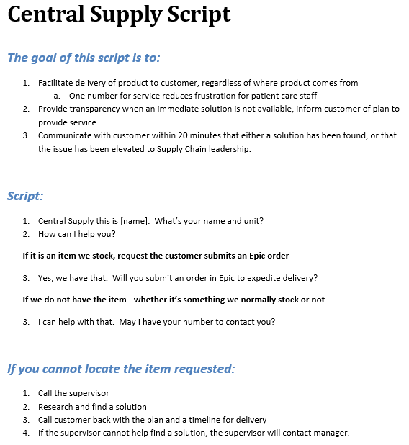
SCRIPT GOALS
Communicate with staff WHY you are implementing a script
Should relate to service agreement

Slide 34
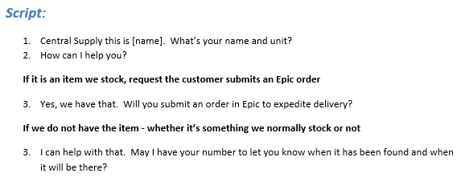
THE SCRIPT
Drives conversation
Concise way of getting necessary info

Slide 35
LOST IN TRANSLATION?
What you’re saying and HOW you’re saying it!
Match tone
Repeat back
Phonetic alphabet (NATO alphabet)
Digits and leading zeroes
15 = “one-five”, 50 = “five - zero”
0.9% saline = “zero point nine”

Slide 36
ELEVATING ISSUES
What happens when there’s a problem?
Needs a standard approach

Slide 37
IMPLEMENTATION
Find a champion in department
They can precept others
Additional training resources may be available
Utilize hospital education
Websites and YouTube videos for phone etiquette

Slide 38
ROUNDING

Slide 39
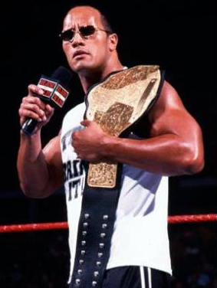
This is your opportunity to market your department!
This is NOT the time to take lashings

Slide 40
BEFORE YOU START...
Gather all your performance metrics
The good and the bad – need transparency to build trust
“Go See”
Pick your audience and tailor the content
OR Manager/Director, OR Supervisors, SPD Supervisors, Frontline Staff

Slide 41
BASE ON SERVICE AGREEMENTS
Share department performance
Are you meeting all your targets?
Are you working on improvement projects?
Now is the time to report any issues with customer not completing their piece of the agreement

Slide 42
DURING ROUNDING
Share information
Gather feedback
What is their perception?
Do the metrics and the perceptions match?
Do you need to create any action plans?
Take notes!

Slide 43
POST-ROUNDING
Send out recap
Share any action plans and ETA of implementation/completion
Schedule your next session!
Ask – was this helpful, did you find value?

Slide 44
IN CONCLUSION
Everything you do in your department should be driven by the service agreement
Scripting can elevate your professionalism and create a flawless customer experience
Rounding is your avenue to showcase your successes

Slide 45
Questions?

Slide 47
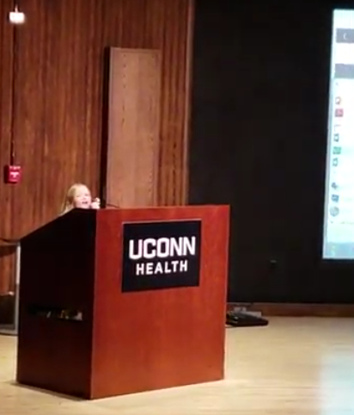
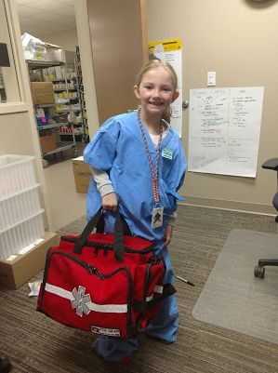
Live your “WHY”

Slide 48
Bibliography
1. ANSI/AAMI ST79:2017. Comprehensive guide to steam sterilization and sterility assurance in health care facilities. Arlington, VA: Association for the Advancement of Medical Instrumentation.
2. Association of periOperative Registered Nurses. Guideline for manual chemical high-level disinfection. In: Guidelines for Perioperative Practice. Denver, CO: Association of periOperative Registered Nurses, 2018

