Slide 1
Teamwork and Communication within the CSSD throughout the process
Forecasting, Huddles, scripting,
and loaner drop offs.

Slide 2
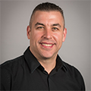
David Jagrosse Consulting LLC CRCST CHL
SPONSORED BY ONESOURCE
Connecticut Central
Service Association
Service from 1994 through today
President 2008 09 10 11 12 13 DONE!!
Former CSSD Tech Supervisor and
Past Manager Middlesex Hospital
AAMI STWG40 (ST79) voting member
IAHCSMM Ortho council past member
IAHCSMM Executive Board 2011-12 2012-2013
IAHCSMM President Elect 2013-2015
IAHCSMM President 2015-2016
IAHCSMM immediate Past President 2016
IAHCSMM Past president
Director Speakers Bureau Oneource
David Jagrosse Consulting L.L.C.President.
Consulting to medical vendors, Speaking/Education and
AAMI Based Audits for medical facilities
203-465-8502

Slide 3
Objectives:
Discuss and define Teamwork
Discuss and define Communication
Case study of process at Middlesex Hosp
Forecasting of surgical schedule
Team Huddles
Scripting with Vendors
Drop off log in dept
Day of surgery and post case considerations

Slide 4
Discussion about ‘teamwork”
What do we do?
Why do we do it?
How do we do it?
Empathy, understanding &
Human factors

Slide 5
Communication
Verbal non verbal
Method- email /boards/meetings/huddles
Computer system- Tdoc/ Microsystems/Censitrac etc

Slide 6
Case study of process
Most facilities (hopefully) have some sort of process or procedure (written?) regarding loaners and borrowed equipment and implants. Do you?

Slide 7
If you don’t you better!!
Do you have AAMI ST79 or the CSA standards at hand?
Do you have written policy and procedures?
Are you alive and breathing? Especially during this presentation???
For a start with loaners at least there is IAHCSMM for help…

Slide 8
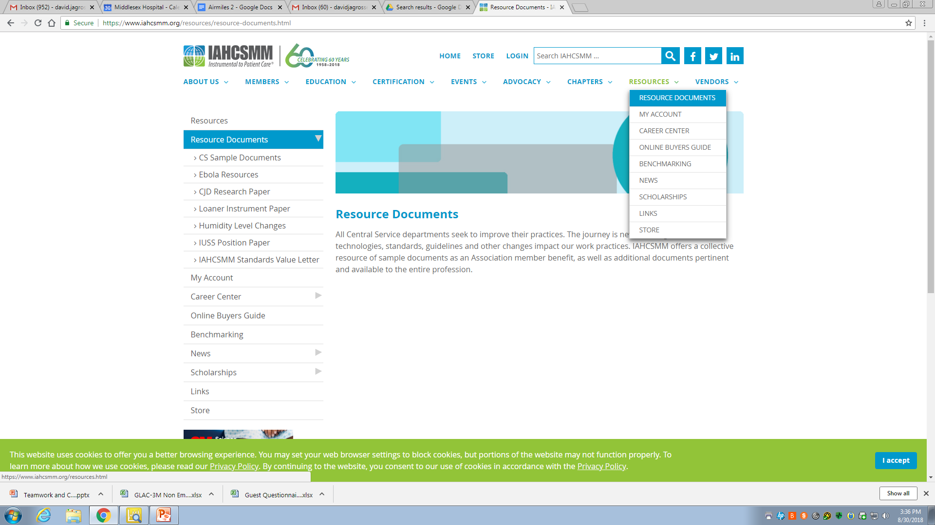
https://www.iahcsmm.org/resources/resource-documents.html

Slide 11
This helps and is a start..
Its only one segment of the process
The process really begins with the Doctor outside of the hospital..

Slide 12
Doctor tells office staff to book case
Calls office typically there is a procedure to book a case at hospital
Handout shows Middlesex Booking slip which lists equipment needs (loaners) etc.
More importantly the doctor is typically vague and office staff are not clinically trained to know our equipment

Slide 13
Doctor calls the reps
Calls reps or has office staff call rep with vague descriptions or requests

Slide 14
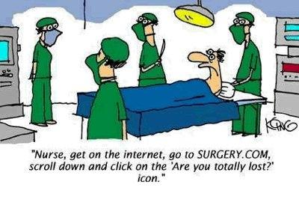

Slide 15
Day before surgery reps show up..
Or a courier or maybe Fedex or UPS
And of course its always during the absolute worse time of the day for CSSD.
Maybe we have what they need maybe we don’t..

Slide 16
Come on Now!!

Slide 17
My case cart

Slide 18
Booking slips
Robust
Specific
Enforced or no case booked
Ask for specifics on equipment
These ‘notes” are added to schedule notes. Especially if equipment is loaner items

Slide 19
FORECASTING

Slide 20
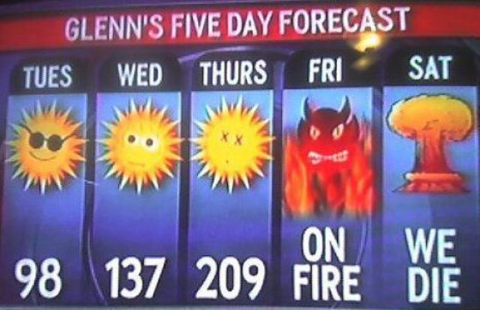

Slide 21
Step one of solution: Forecast
Forecast is printing the schedule a week in advance and looking at cases and notes on cases for equipment requests.
This is the pre-amble to the Huddle

Slide 23
@@@@@@@@@@@@@@@@@@@@@@@@@@@@@@@@@@@@@@@@@@@@@@@@@@@@@@@@@@@@@@@@@@@@@@@@@@@@@@
√
√

Slide 24
Next step HUDDLES
Team Huddle
O.R. /CSSD/Booking and whomever is a stakeholder
Quick and to the point. Less than 20min
Look at next 5 business days
Reps are confirmed
Equipment verified for cases within
24-48 hrs

Slide 25
Post Huddles: Scripting
CSSD lead call vendors and reps
We called it scripting because we wrote a script duh!! See handouts
See sheet for bullets that mattered to us.
This changes the dynamic of the loaner drop off later so when a rep shows up we don’t say “who the heck are you” we say ‘We were expecting you where's our 4 pans and IFU’s!!”

Slide 28
Scripting:
This is your enforcement tool
48 hr rule
IFU’s
How many pans
25lb rule
Approved for use?
Scripts are matched to
drop off logs in CSSD later in process
Whatever you need to enforce

Slide 29
Back to OR huddle again
For cases that are 24-48 hrs out the reps are confirmed on the schedule and any last minute schedule notes or equipment questions are resolved

Slide 30
CSSD Huddle
Daily
Quick 15 min
Not a complaint session.
Covers
safety
Today's priorities (loaners turnovers)
Tomorrows priorities (loaners turnovers)
Gen hosp announcements
Whats Dave doing today ---for real!

Slide 32
Drop off 48 hr before surgery
It can happen if you
make it happen

Slide 33
It’s an engagment!

Slide 34
Drop off engagement
Face to face to ask questions
Script is matched to drop off logs
“We were expecting you”
What there is only 3 pans??
Where's the 4th? Ohh its coming later!
Any discrepancies are resolved asap
NO IFU NO processing-Policy

Slide 36
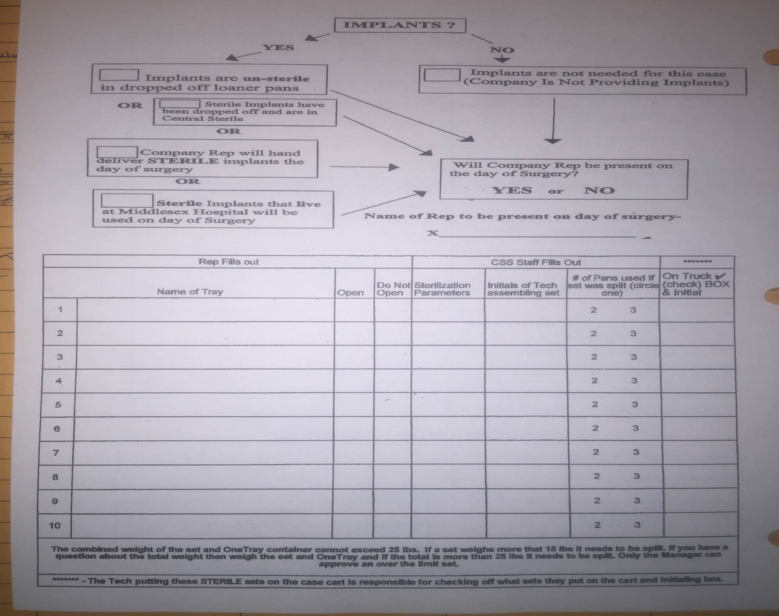

Slide 37
At this point you can use IAHCSMM docs
Use IAHCSMM loaner policy as guide
Develop what works for your facility
Tracking system? No..paper system
Use Tyvek tags for marking
Label sets Open only if necessary
WASH ALL SETS REGARDLESS!!
Look for peeling rubber coatings on pans

Slide 38
Other tips and hints …
Reallocation of unused pans
Hold area for ‘clean” pans
Hold reps responsible for cleanliness check at drop off. Partners in grime
I will make these slides available to your chapter

Slide 39
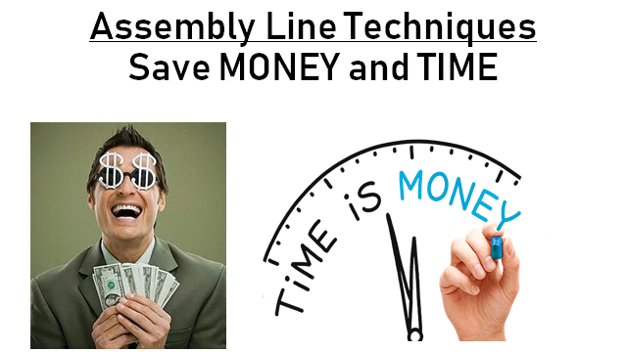

Slide 40
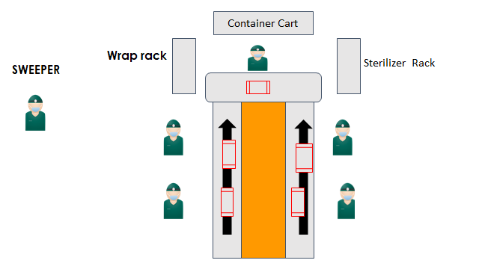
Cases
4 and 6
Case 5
Cases
1 and 2
Case 3

Slide 42
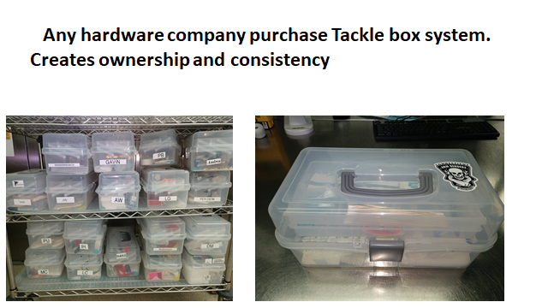

Slide 43
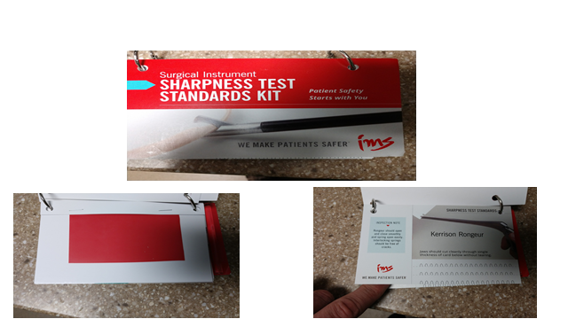

Slide 45
Join the Fight
"Those who expect to reap the blessings of freedom must, like men, undergo the fatigue of supporting it." Thomas Paine

Slide 46
Change will not come about through expectation –Dave Jagrosse

