Slide 1
Assessment & Enhancment of the
CSSD 2019 and Beyond

Slide 2
David Jagrosse Consulting LLC CRCST CHL
SPONSORED BY ONESOURCE
Connecticut Central
Service Association
Service from 1994 through today
President 2008 09 10 11 12 13 DONE!!
Former CSSD Tech Supervisor and
Past Manager Middlesex Hospital
AAMI STWG40 (ST79) voting member
IAHCSMM Ortho council past member
IAHCSMM Executive Board 2011-12 2012-2013
IAHCSMM President Elect 2013-2015
IAHCSMM President 2015-2016
IAHCSMM immediate Past President 2016
IAHCSMM Past president
Director Speakers Bureau Oneource
David Jagrosse Consulting L.L.C.President.
Consulting to medical vendors, Speaking/Education and
AAMI Based Audits for medical facilities
203-465-8502

Slide 3
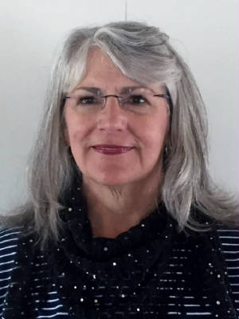
SEAVEY HEALTHCARE CONSULTING® STERILE PROCESSING SURGICAL SERVICES . 303-467-0868 office/fax www.seaveyhealthcareconsulting.com Established in 2003 Sterile Processing Best Practices Audit Check Sheet
Hail to my “work mom”
Rose Seavey. Retired!
Expert,Mentor,Guide, Friend
Rose Seavey, MBA, BS, RN, CNOR, CRCST, CSPDT, is president and CEO of Seavey Healthcare Consulting, Inc. in Arvada, CO, having previously served as the director of the sterile processing department at The Children’s Hospital of Denver. She is a member of numerous AAMI working groups focused on developing sterilization and reprocessing standards and is the author of Sterile Processing in Healthcare Facilities: Preparing for Accreditation Surveys.

Slide 4
BUY THIS BOOK!!!!! AAMI.ORG
Preparing for Accreditation Surveys, 3rd Edition
This book provides valuable tools for preparing for accreditation surveys and maintaining compliance with accreditation requirements as they relate to sterile processing. New to this third edition are best-practice audit tools for immediate-use steam sterilization (IUSS) and high-level disinfection (HLD), and an instrument integrity checklist. It has also been updated to reflect the 2017 revision of ANSI/AAMI ST79 and current TJC accreditation standards related to sterile processing. TJC's new SAFER matrix scoring methodology is also discussed.

Slide 5
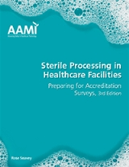
The efficacy of any sterilization process depends on four phases: 1. A consistent system for lowering and limiting bioburden before sterilization, 2. Properly preparing items for sterilization, 3. Selecting the appropriate sterilization parameters, and 4. Establishing and implementing controls to maintain the sterility of sterilized items until they are used.

Slide 6
The delivery of sterile healthcare products for use in patient care depends not only on the efficacy of the sterilization process itself but also on the following five factors:
*efficient facility design,
*proper training of personnel,
*good infection prevention and control practices designed to prevent health-care-associated infections,
*effective quality controls and process improvement systems that encompass all aspects of device reprocessing from point of use through sterilization to reuse, and
*appropriate documentation and reporting practices that enable traceability to the patient.

Slide 7
PERFORMING AUDITS
Critical aspects of infection prevention include proper reprocessing procedures and sterility maintenance. Facilities should perform routine audits for all reprocessing and sterilization areas. These audits should be conducted by the reprocessing manager and the IP.
The following is a list of important issues to monitor based on ANSI/AAMI ST79:2017 Comprehensive guide to steam sterilization and sterility assurance in health care facilites. Some monitoring issues are based on AORN guidelines.

Slide 8
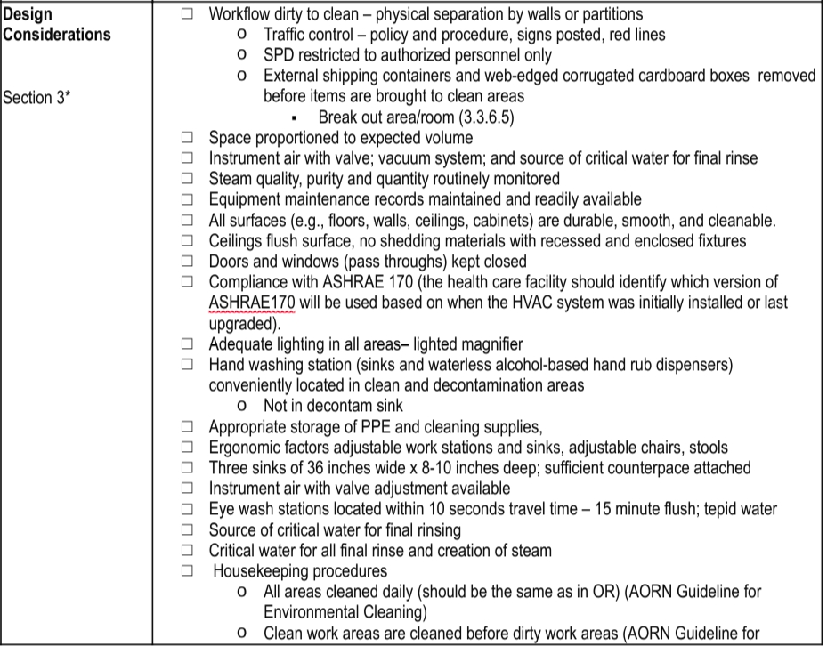

Slide 9
MAKE SURE FACILITIES IS FOLLOWING NEW ASHRAE STANDARD 170 PER AAMI ST79 2017

Slide 10
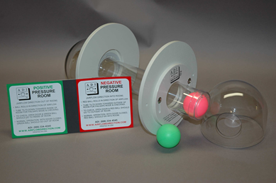
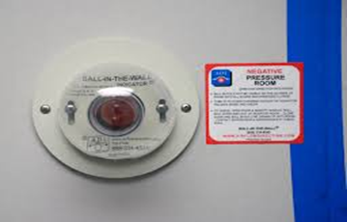
Ball in the wall monitors. Hundreds of dollars plus install cost is best practice

Slide 11
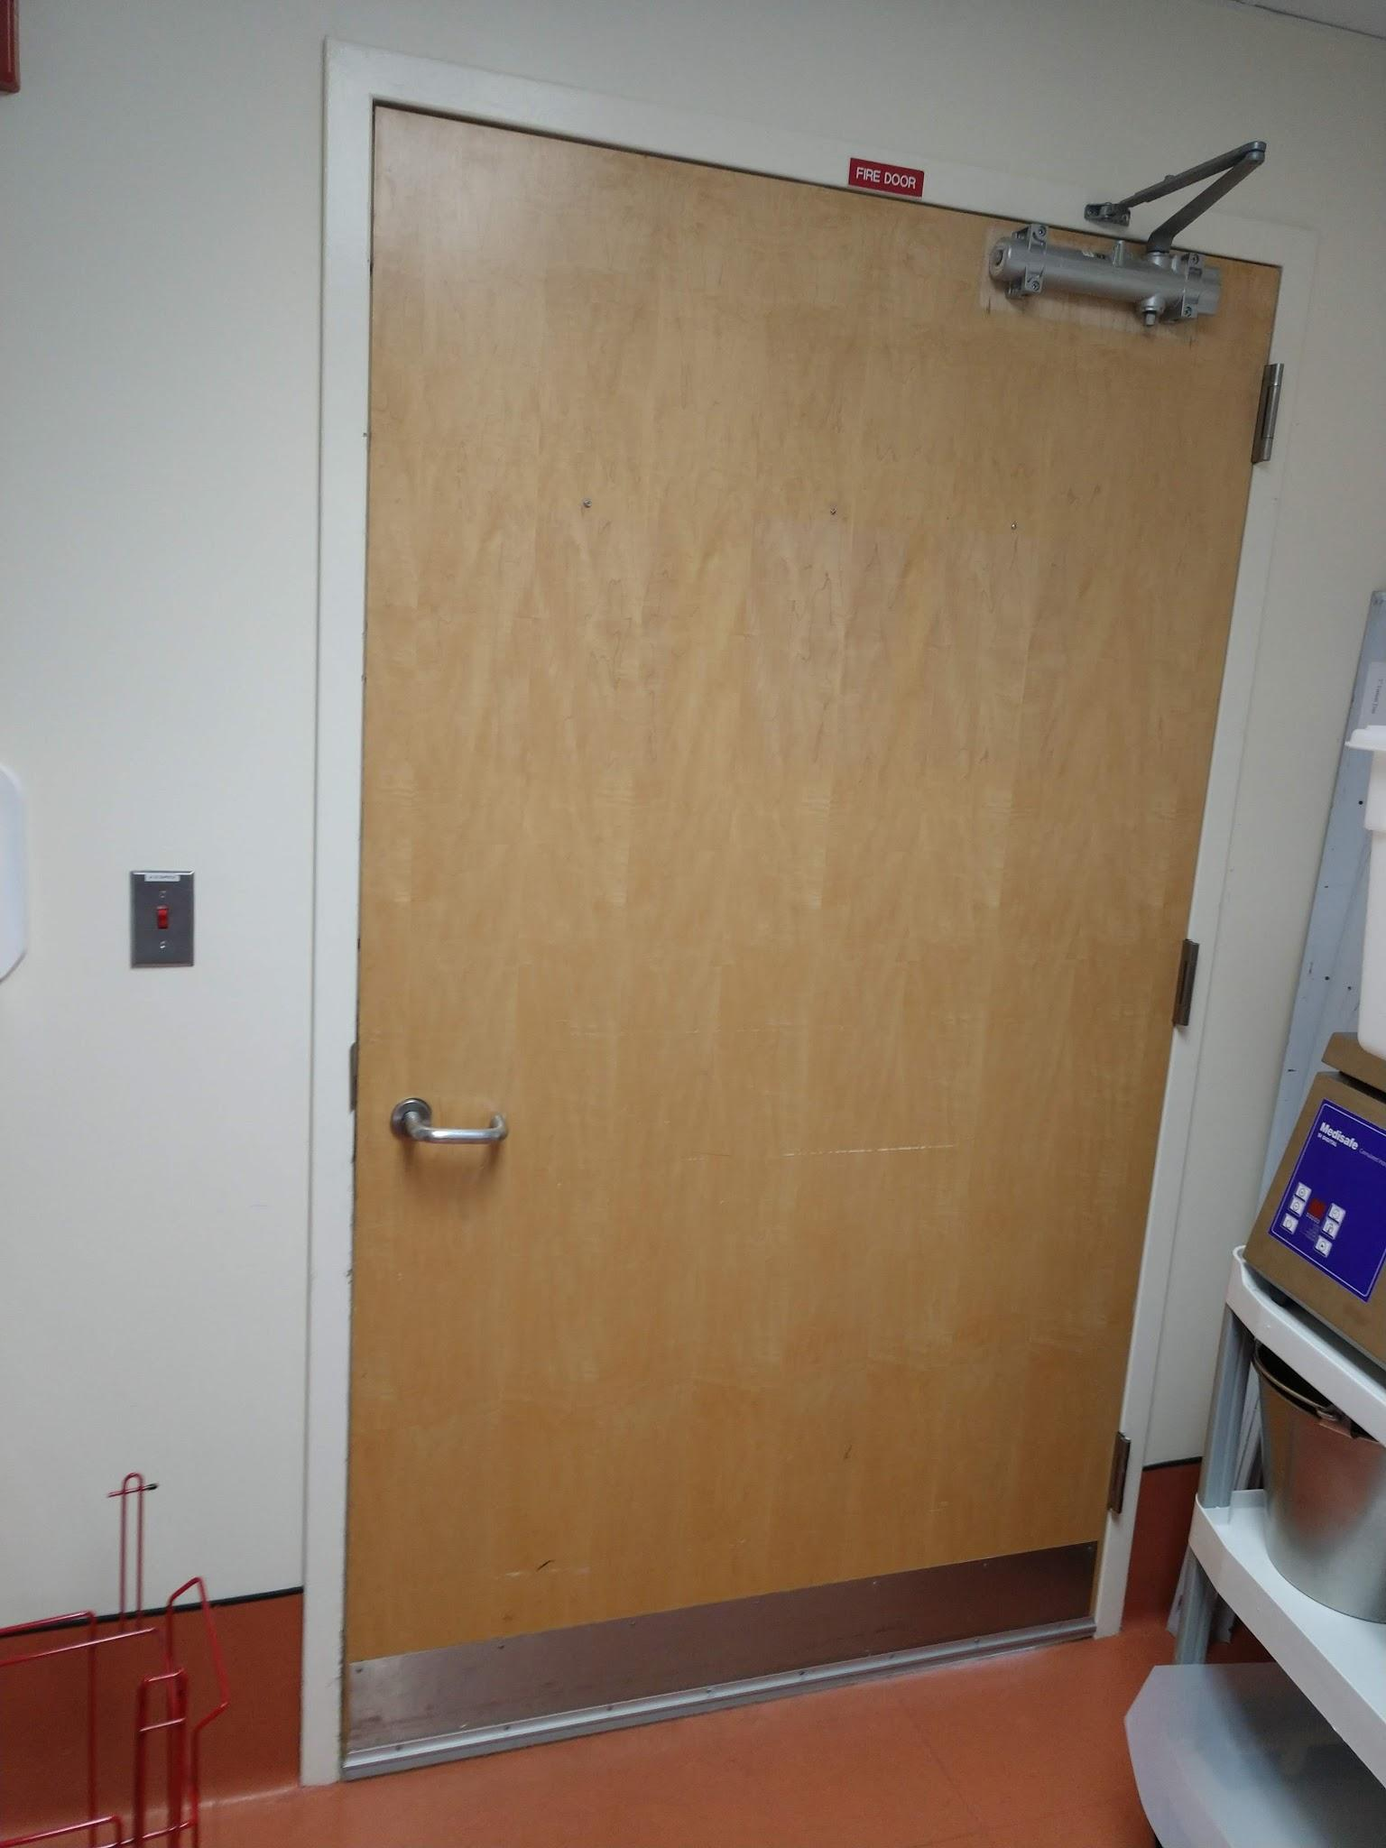
Any door should have a window for staff safety

Slide 12
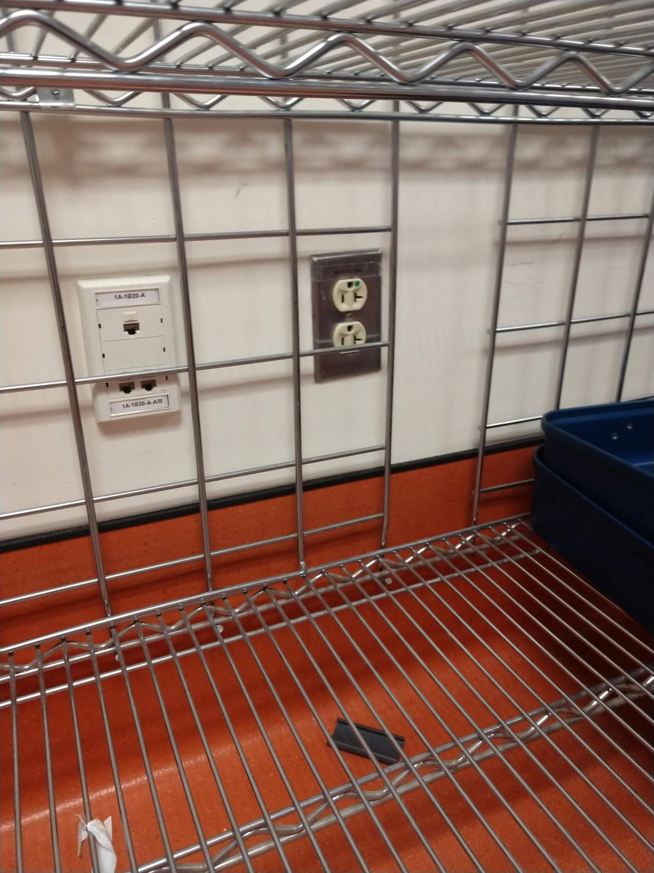
Ensure plugs in decontam or wet areas are GFI protected

Slide 13
STEAM QUALITY

Slide 14
WETPACKS

Slide 17
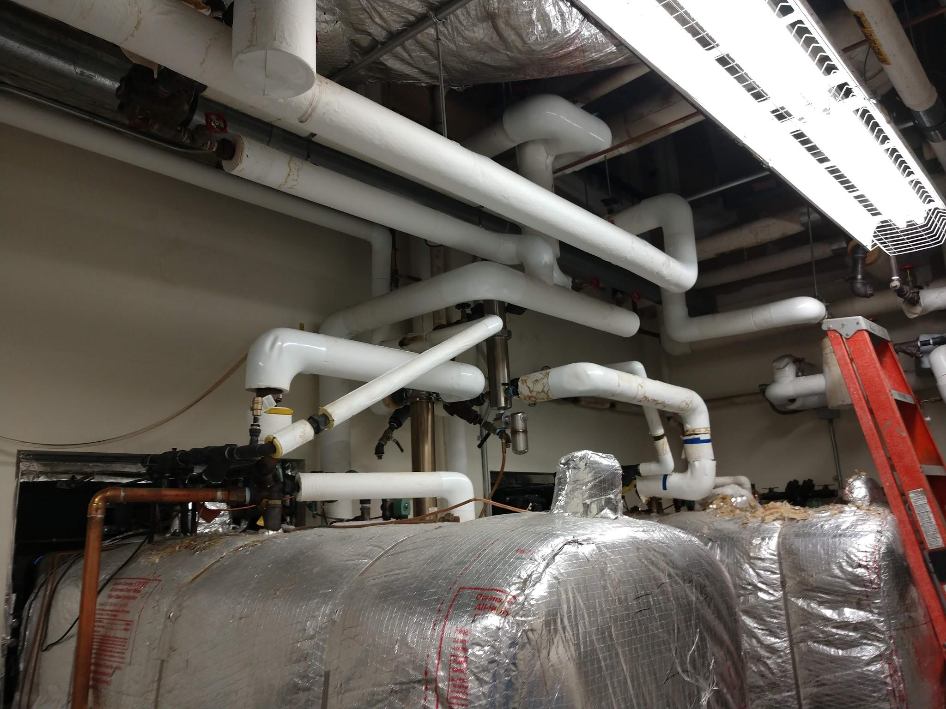
David Jagrosse Consulting LLC can have review done by Dr Jonathan Wilder

Slide 18
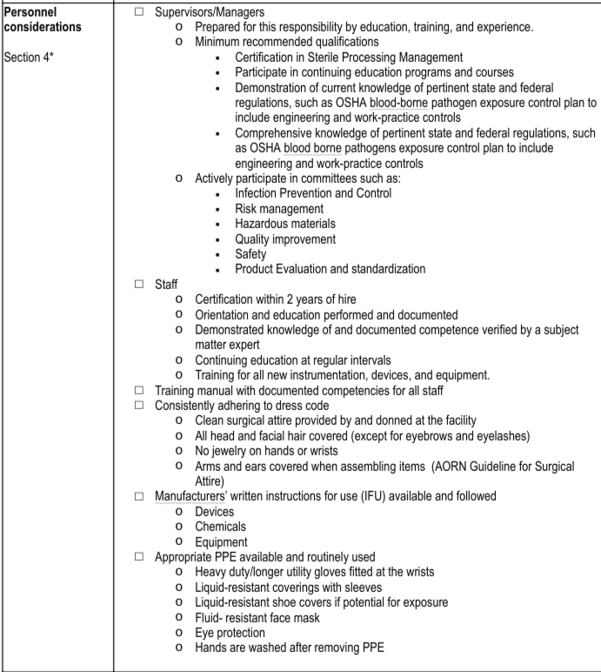
Resume building!
IFUs!

Slide 19
DON’T BECOME A TRAINING FACTORY FOR THE HOSPITAL UP THE STREET!!!

Slide 20
*Repair Program
*Cleaning Verification
*New Staff training
*Schedule and duties

Slide 21
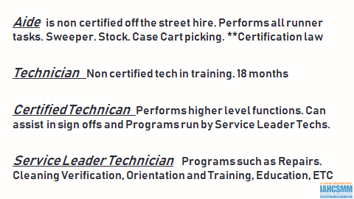

Slide 22
WE WILL GET BACK TO THIS LATER AND PUT IT ALL TOGETHER

Slide 23
REPAIRS AND IFUS-UPDATED ACCESSIBLE AND FOLLOWED

Slide 24
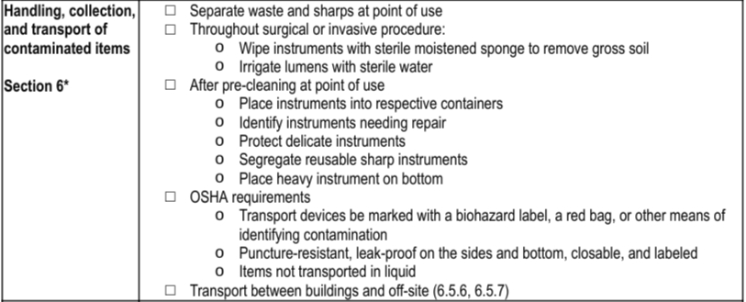

Slide 25
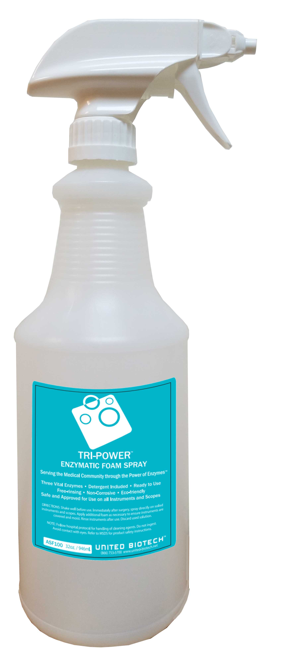
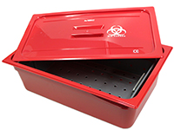
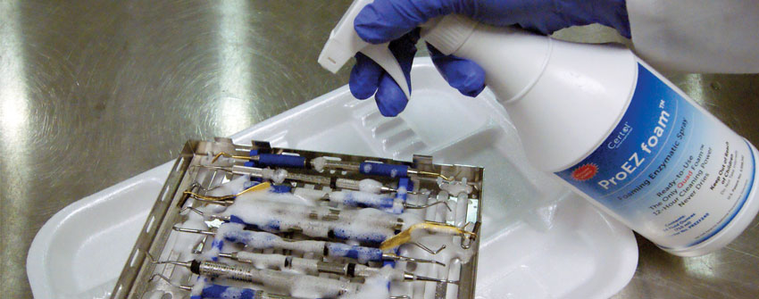
Soiled Instruments from OR

Slide 26
AAMI ST:79 2017 Standards - Point of Use Cleaning
6.3.1 - Throughout the procedure, instruments should be wiped, as needed, with sterile moistened surgical sponges to remove gross soil. Cannulated instruments should be irrigated with sterile water, as needed, without creating aerosols.
6.3.2 - Gross soil should be removed as soon as possible
6.3.3 - All instruments opened in the procedure room should be considered contaminated
6.3.4 - Instruments should be opened and disassembled
When handling contaminated items personnel should wear appropriate PPE (4.5), remove soil by a method that does not promote cross-contamination (avoid splashing areas near sinks).
Prior to transport, instruments should be prepared in such a way as to prevent organic soils from drying (moistened towel, humipak, or pretreatment product)

Slide 27
AAMI Standards - Transport of Soiled Instruments
OSHA requires that:
all containers, devices, or carts used for containing contaminated items be marked with a biohazard label, a red bag, or other means of identifying contaminated contents; and
puncture-resistant, leak proof on the sides and bottom, closable, and labeled containers must be used or devices with edges or points capable of penetrating container or skin

Slide 28
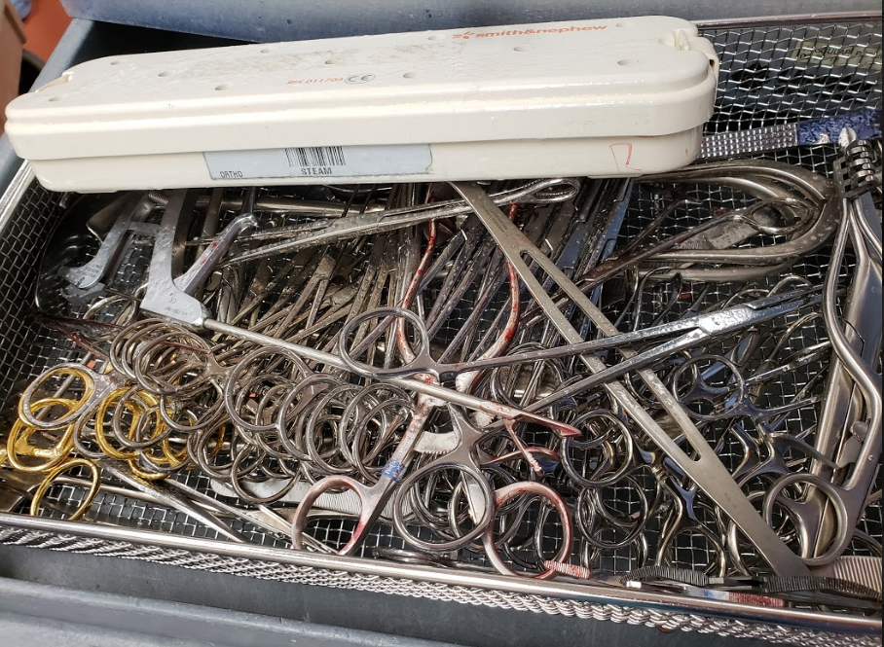
Observed instruments returned to decontam in closed position.

Slide 29
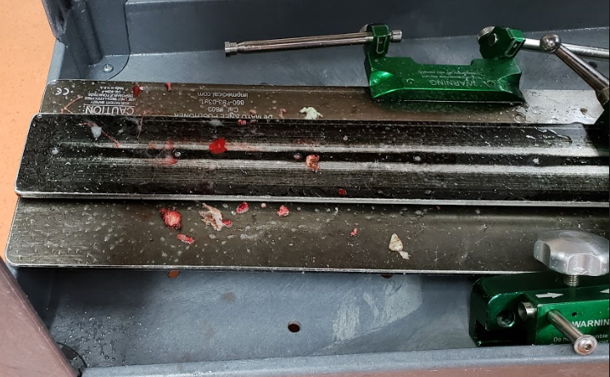
DeMayo positioner returned without gross soil removed. This should be disposed of in OR.

Slide 30
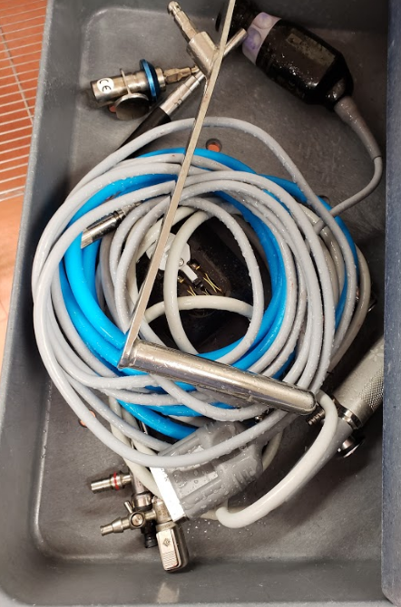
Camera returned to decontam underneath other instruments
There goes $5K and some turn overs for tomorrow!!

Slide 31
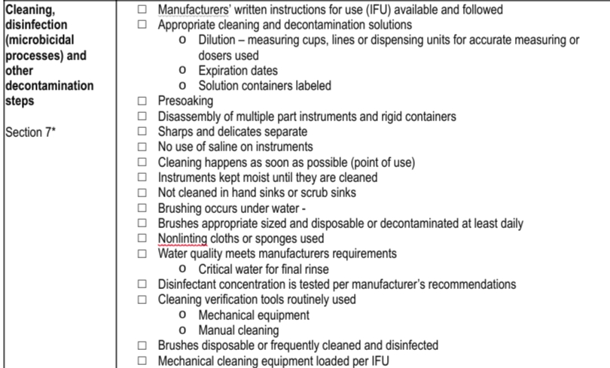
DECONTAM AND CLEANING VERIFICATION PROCESS

Slide 32
Cleaning Verification Program
1. People
Training. Lead tech in charge of program
2. Process
Procedure. Checklists, Maintenance of equipment.
3. Mechanical
Validate the efficacy of equipment and chemistries. In wash Tests. Post wash tests. Critical Water

Slide 33
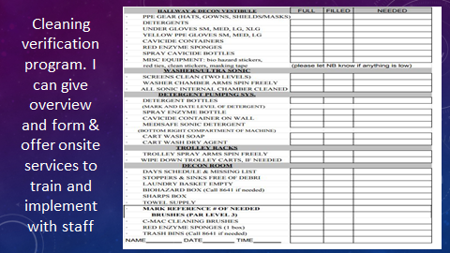

Slide 34
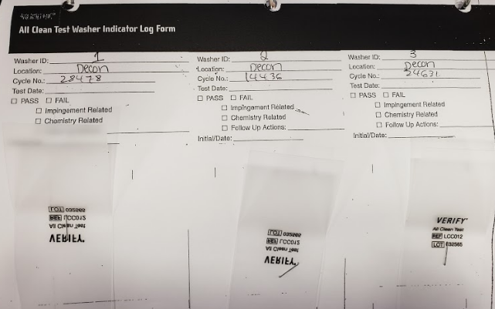
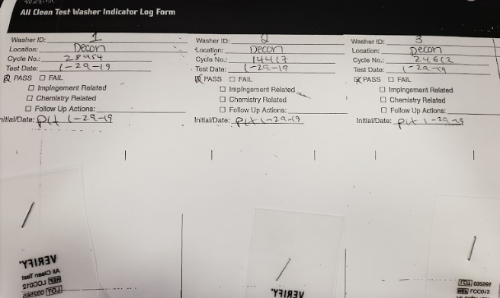
All Clean Test logs not completely filled out.
Interpretation chart needs to be available to determine if failures are impingement or chemistry related. (could be available, just not observed)

Slide 35
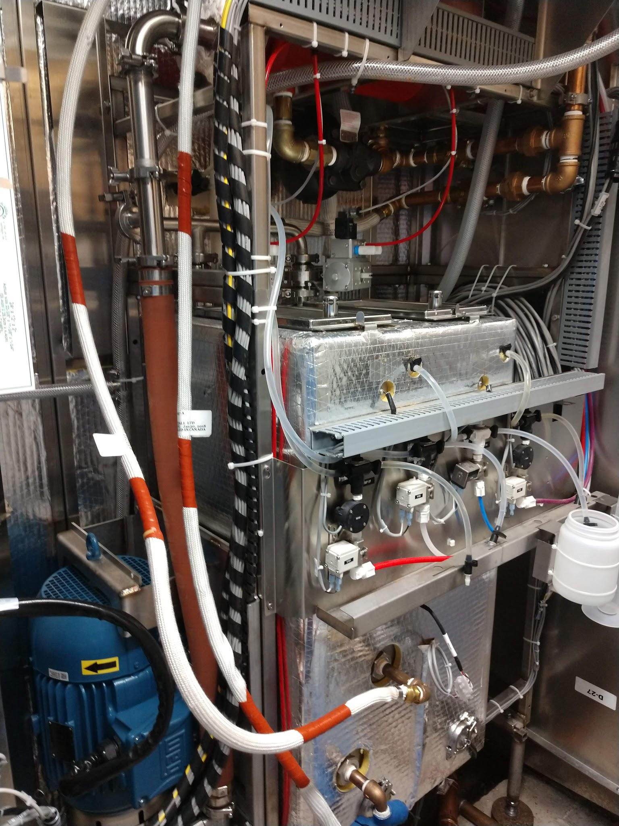
Make sure Cart washer maintenance program includes cleaning the holding tank

Slide 36
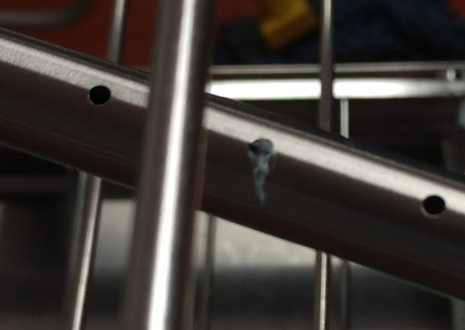
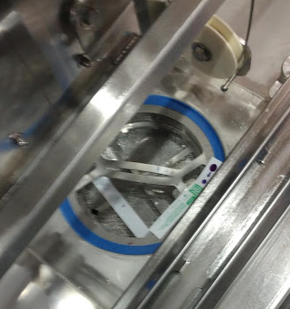
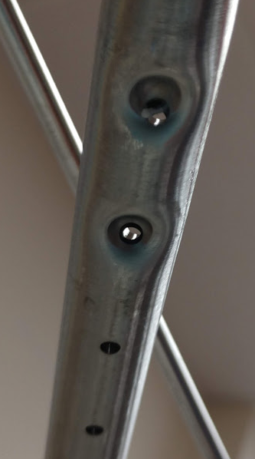
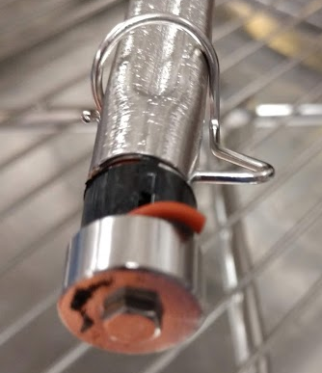
Cleaning verification program will include washer maintenance
(spray arm check and clean, descale, etc)

Slide 37
Review Cycle profiles for washers from MFG as part of review and ensure staff are using appropriate cycles

Slide 38
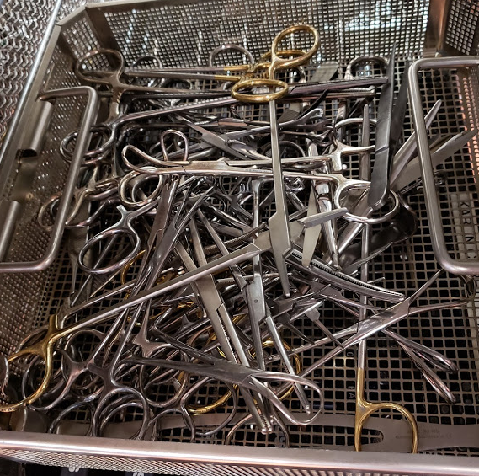
Instruments are sent through the wash in closed position
Unsafe expectation for SPD employees to dig in soiled instruments to separate and open
*Picture is from set in assembly area waiting to be assembled

Slide 39
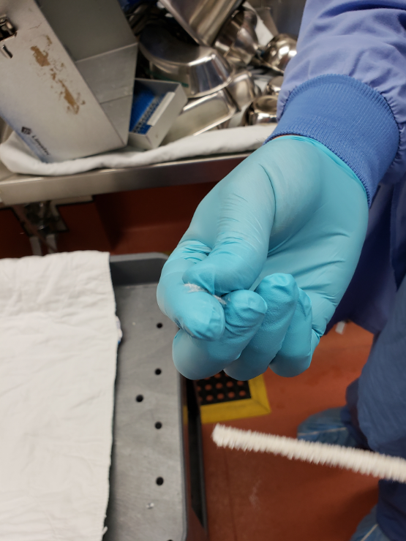
Linting pipe cleaners being used to brush lumens and to hold instruments open. These shed fibers.
Other non-linting options available
Disposable ex - Healthmark
Key Surgical has reusable brushes (follow IFU for when to throw away and how often to clean brushes)

Slide 40
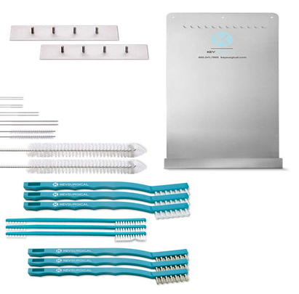
Key Surgical or other brush organizer should be on the wall near the hand washing sink.
Appropriate brushes need to be available for suctions (7fr, 9fr, etc)

Slide 41
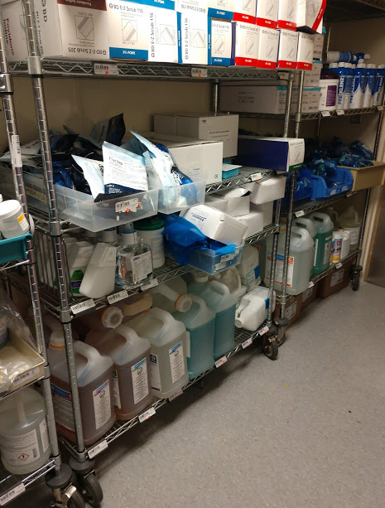
Where is clean brush storage? Assembly?
Clean storage area in decontam to replenish when decontam cheklists are done
Accessible to decontam workers

Slide 42
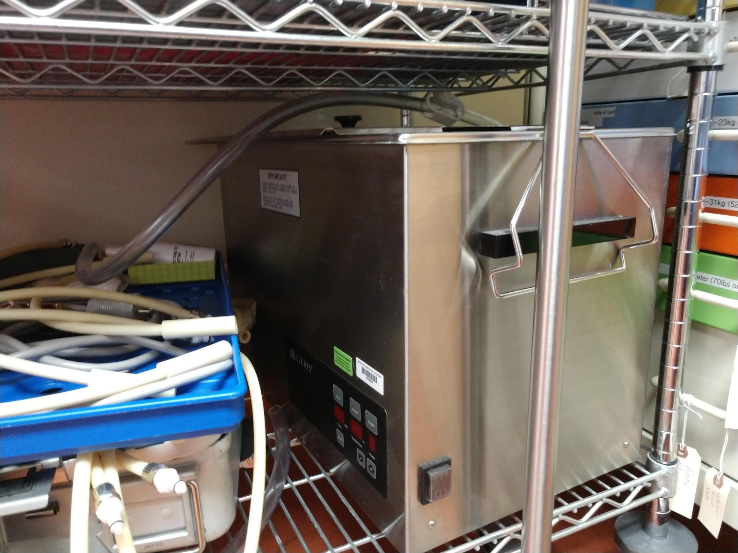
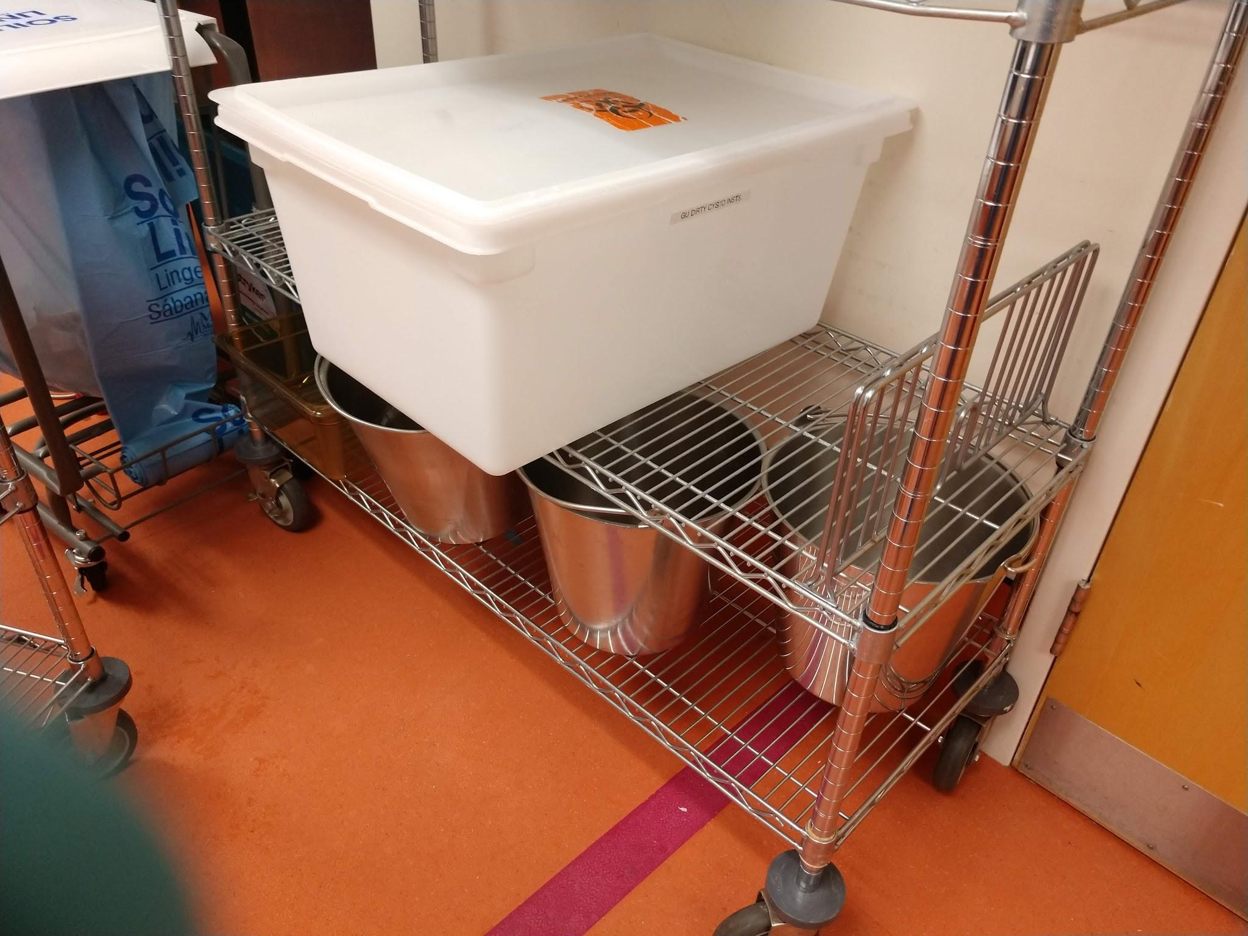
General clean up. Remove items that are not for immediate usage

Slide 43
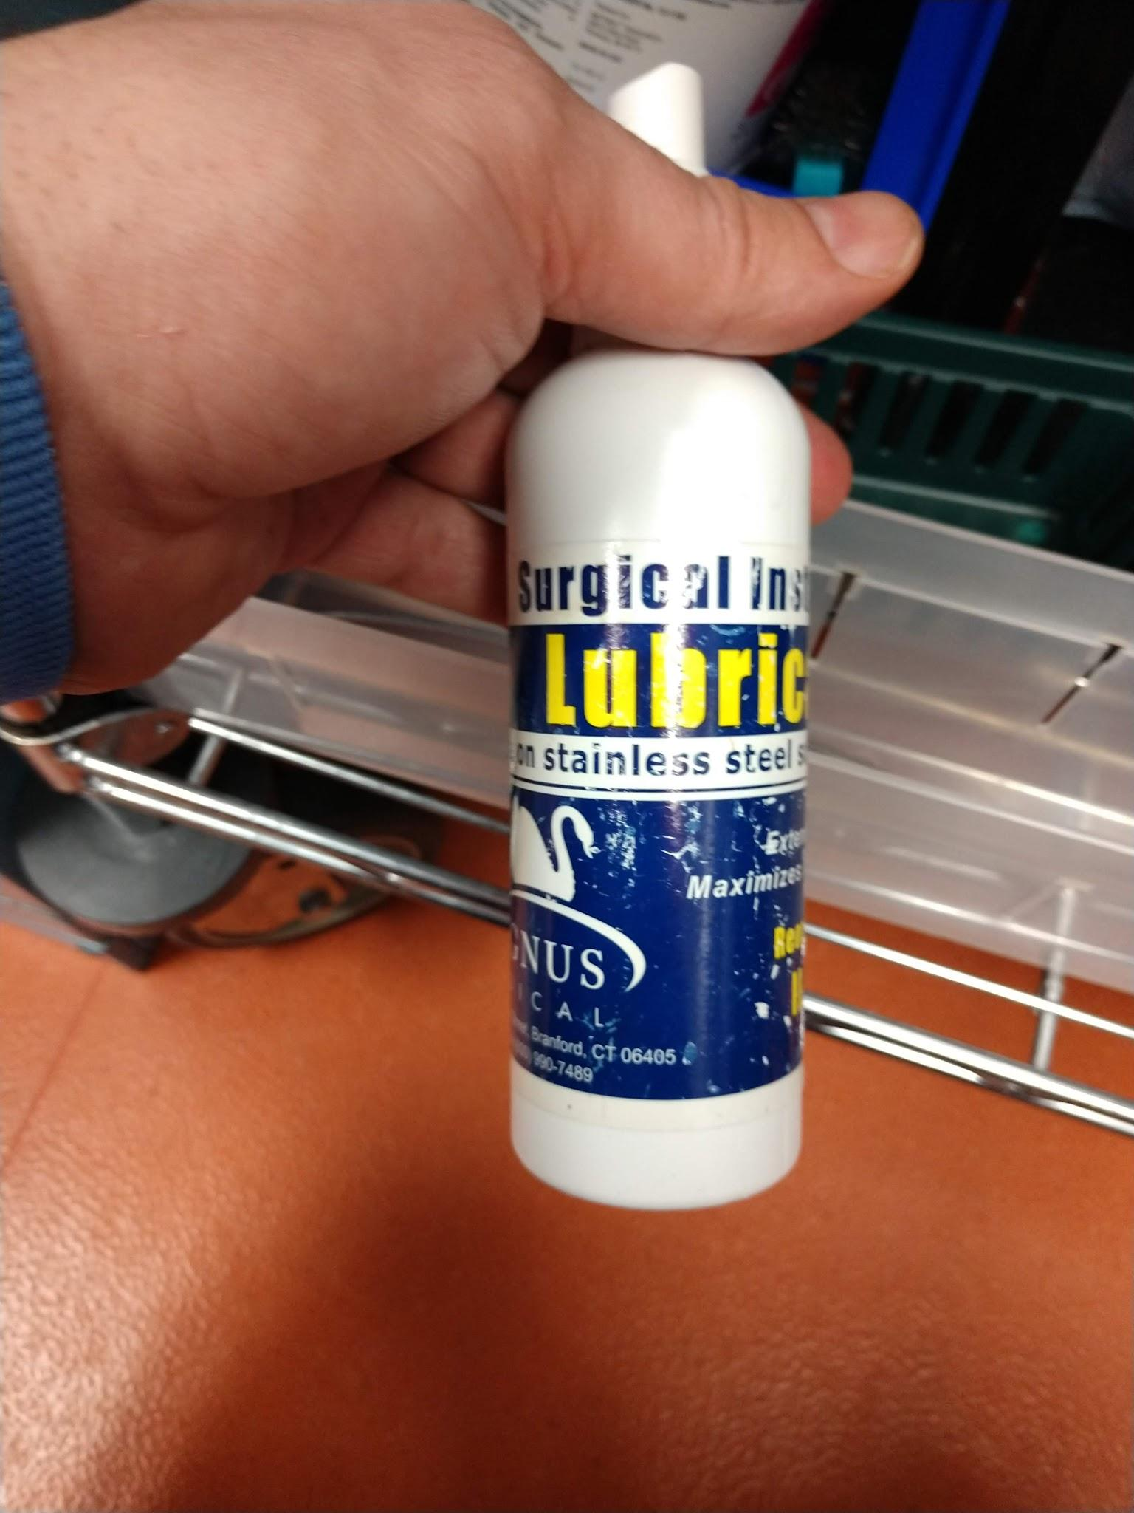
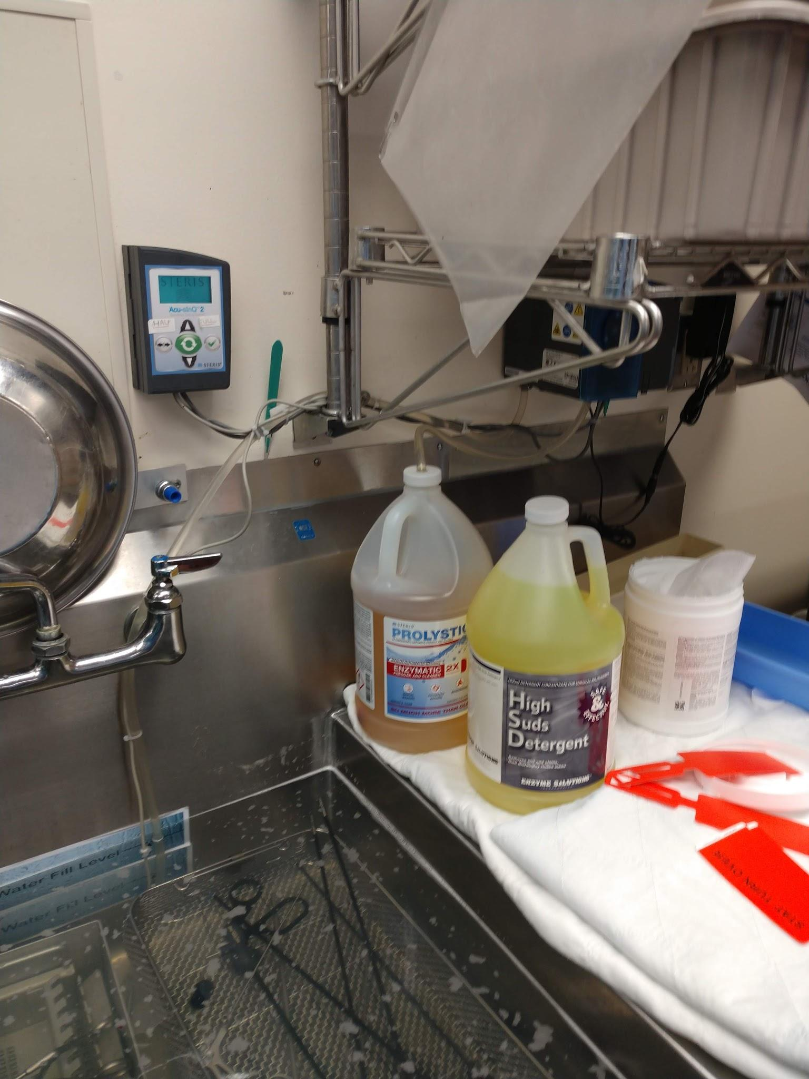
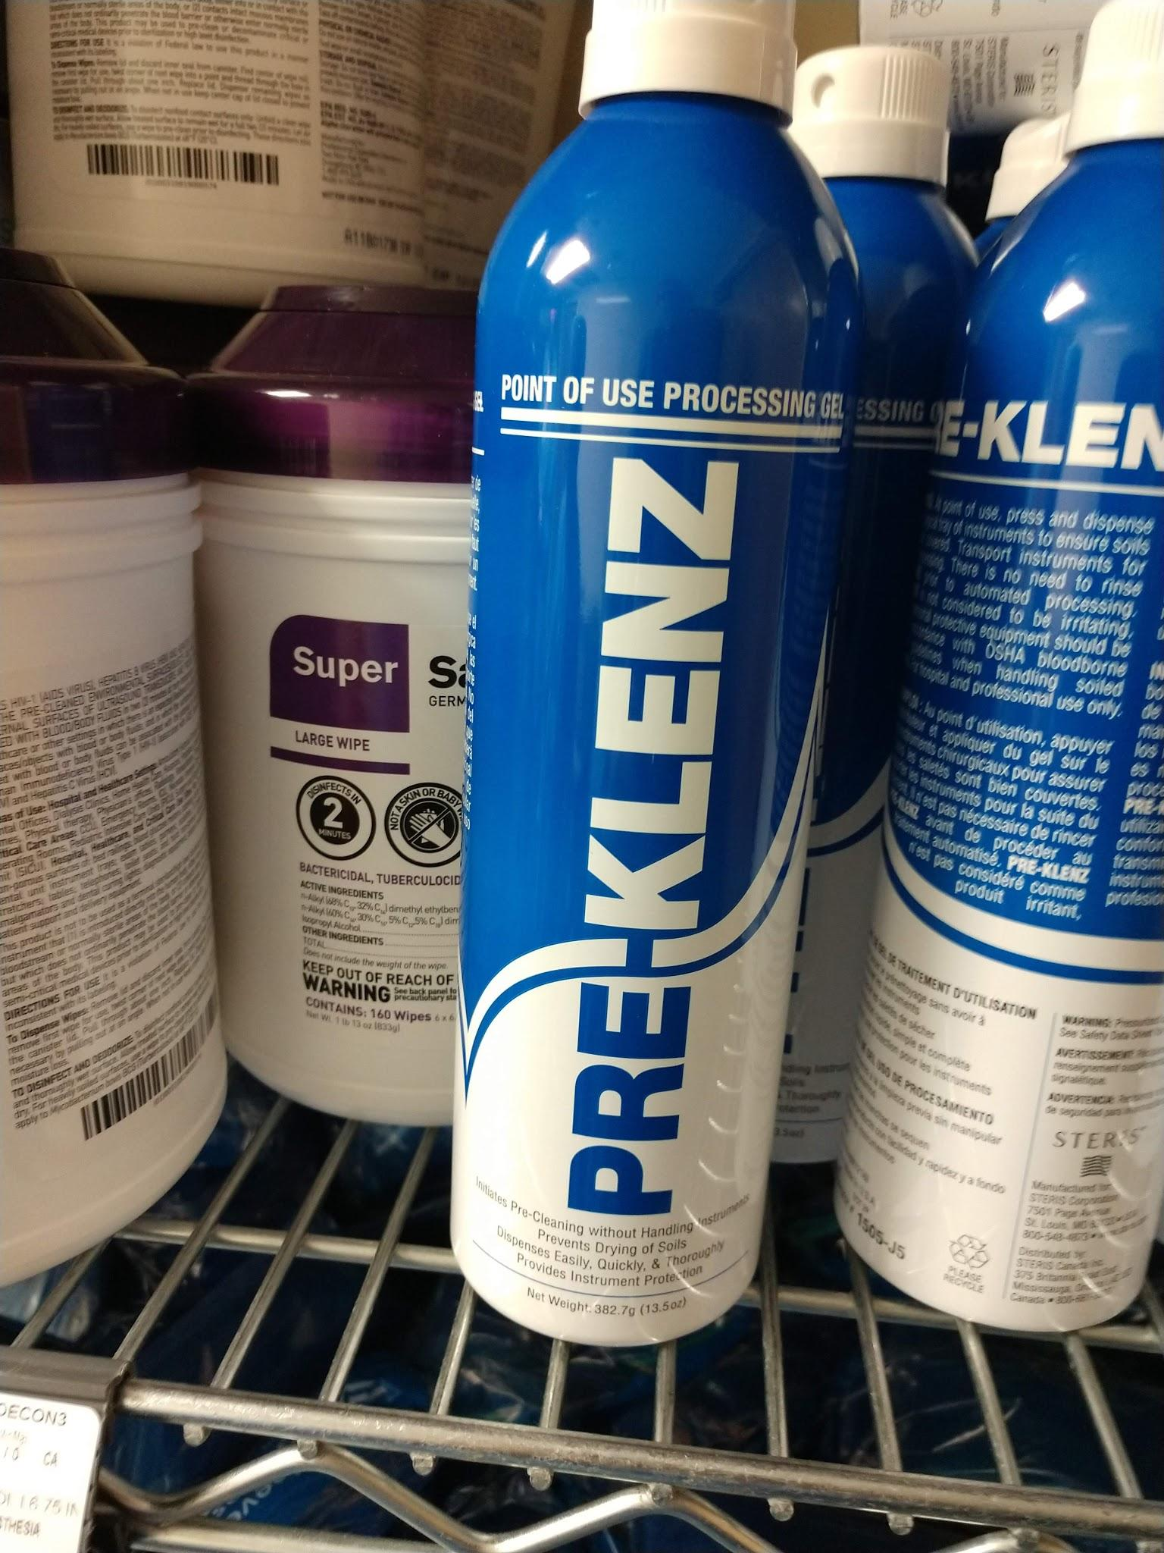
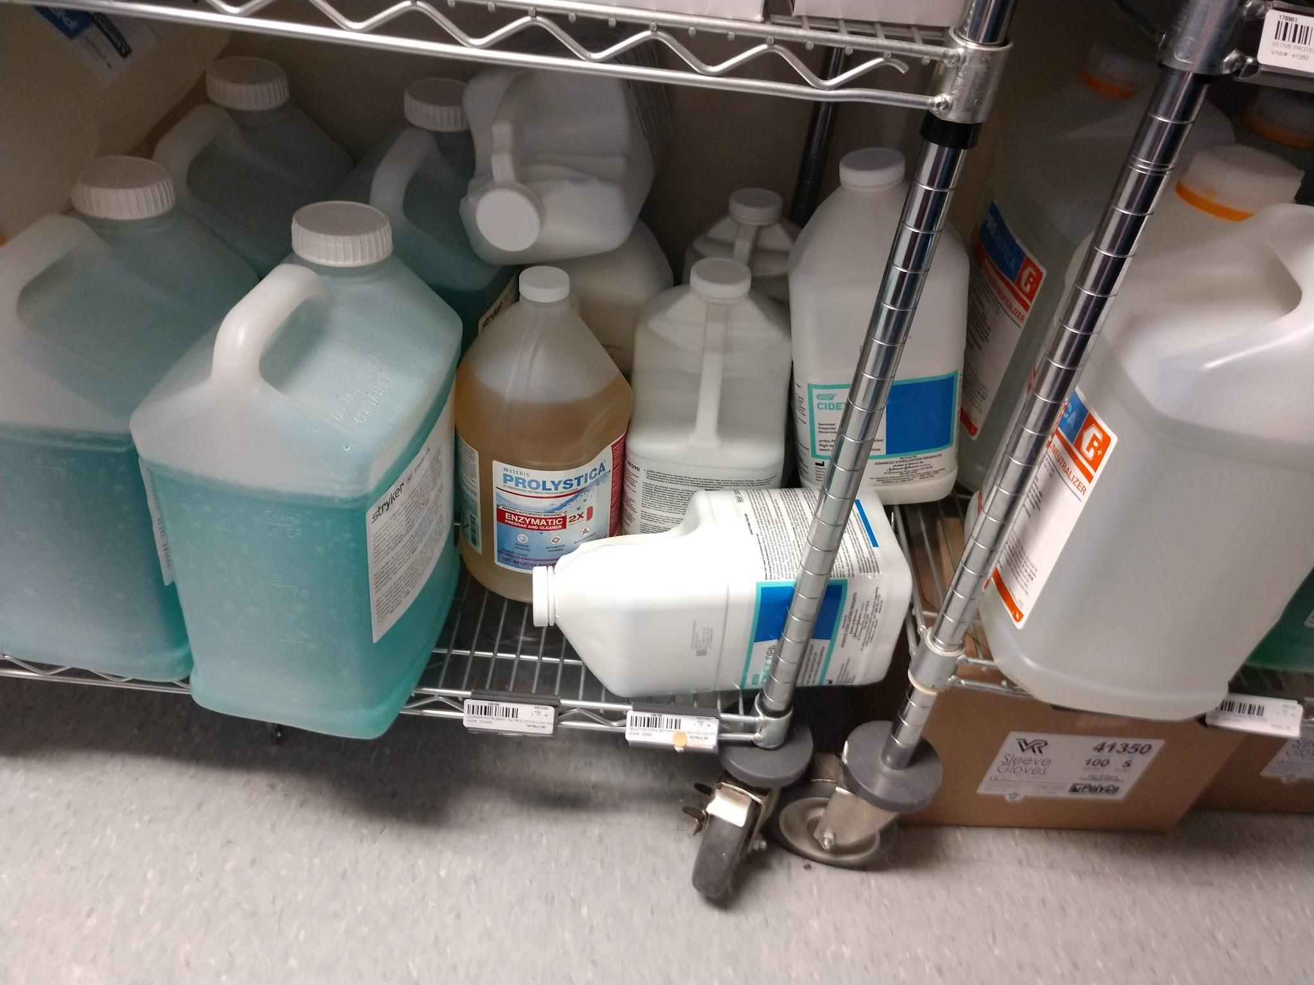
Many cleaning products across the spectrum. Various PH on product. Consider opportunity to switch to one product for washers sinks and cart washer and certified wash cycles. “Milk” bottles on assembly
Use a true enzyme for more effective breakdown

Slide 44
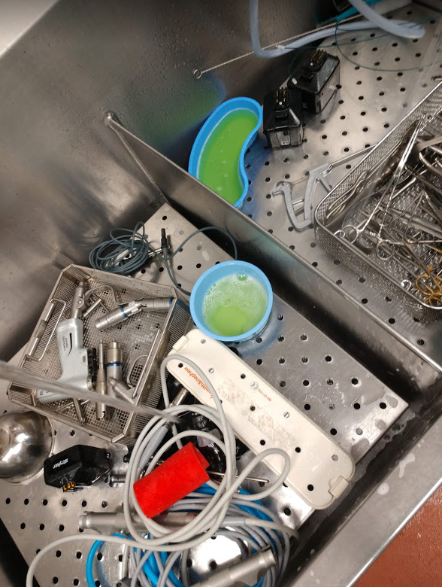
Cleaning activities duplicated in each bay of the sinks
Bays of sinks should follow a linear process flow
Need to review “Suds” product
No critical water (RO, deionized) available for final rinse
No pressurized medical air available
Soiled >>> Clean
Wash
Remove gross soil
Brush lumens
Rinse
RO Water Rinse

Slide 45
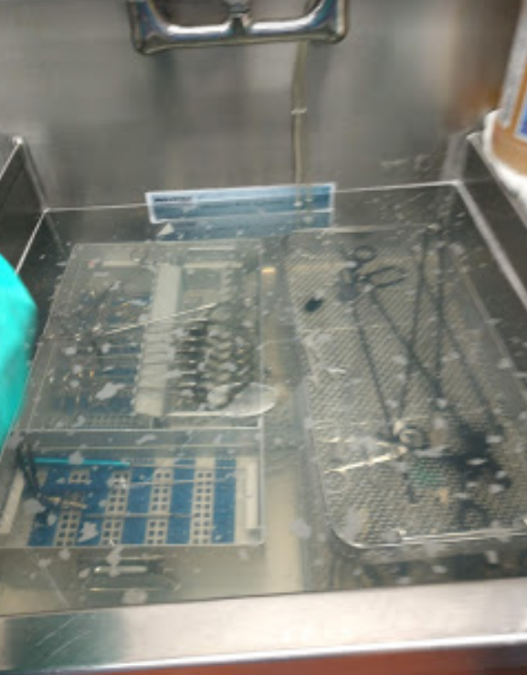
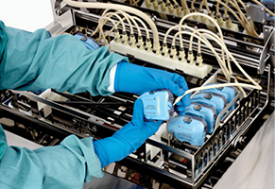
Items that can go through washer should go through ultrasonic.
Cannulated items should go through sonic with irrigator flush ports
Available from Steris

Slide 46
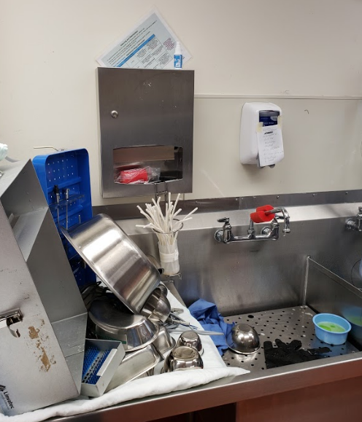
No hand washing sink available in decontam.
Because of the paper towel dispenser, it looks like hand washing would take place in decontam. This practice would not follow AAMI guidelines.

Slide 48
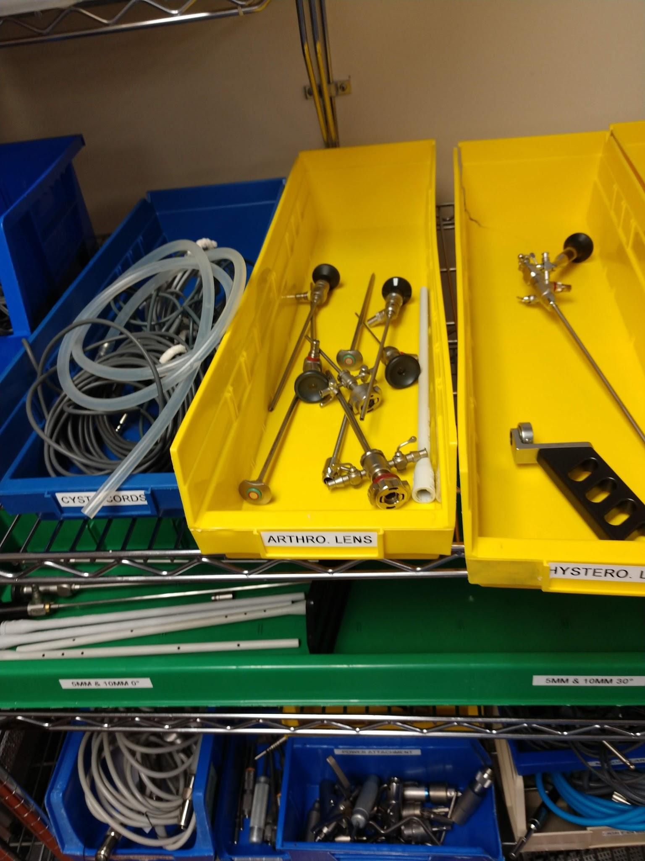
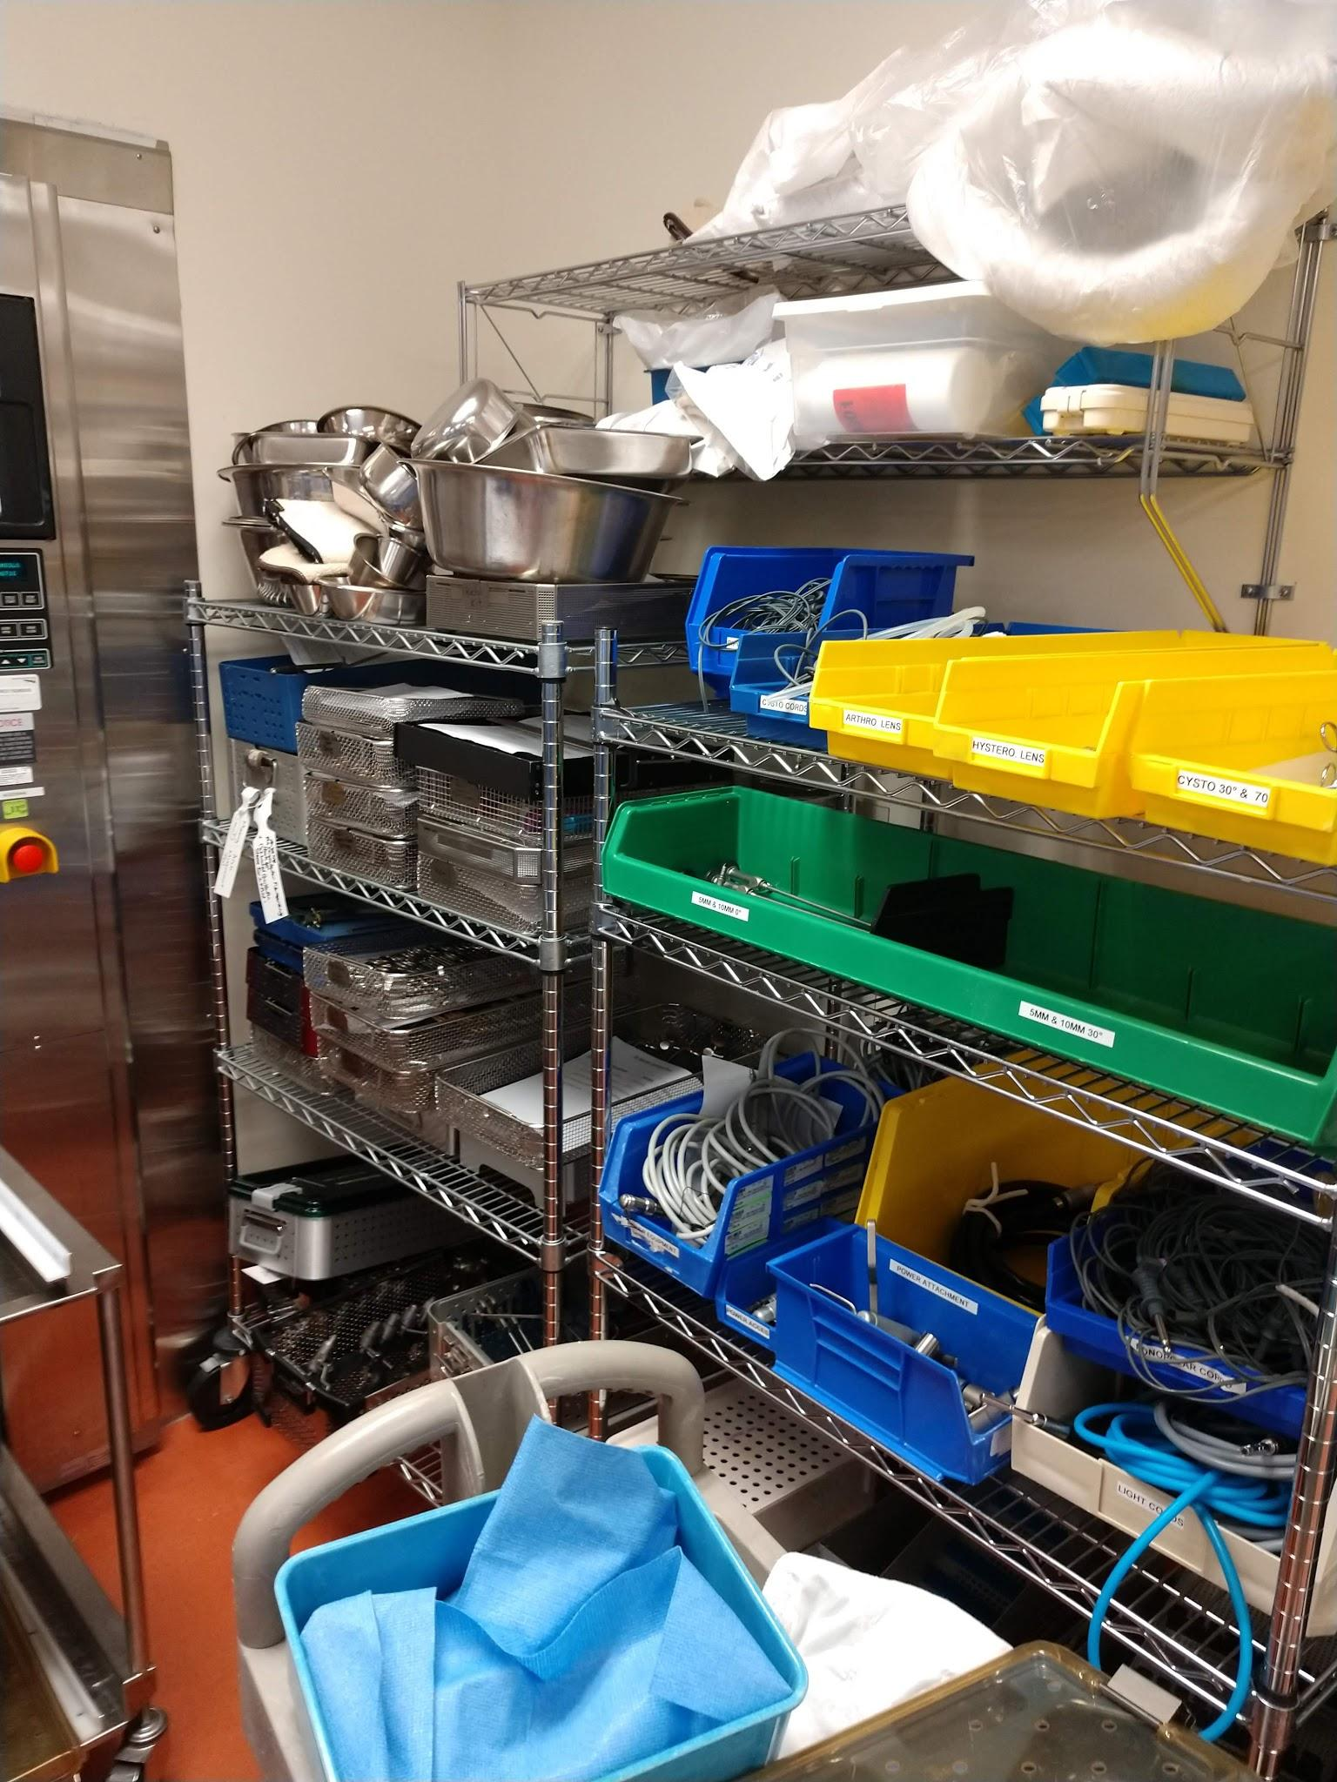
Need protective covers ion scopes to prevent further damage
Assign down sets to Service Leader repair tech

Slide 49
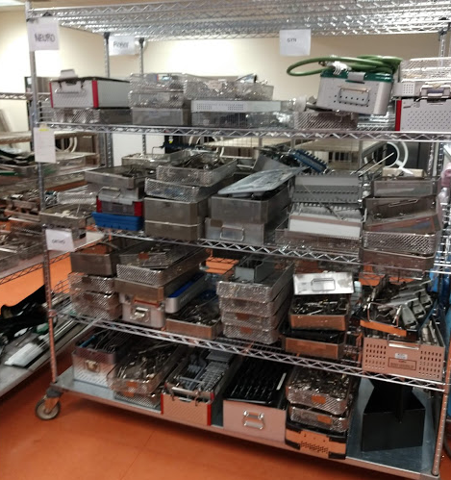
Assembly staging is area of greatest opportunity
Typically unloaded and organized by specialty
Searching for exceptions and priorities??
Someone has to decide what to do next
When is this set going to get done???
WE SHALL DISCUSS LATER

Slide 50
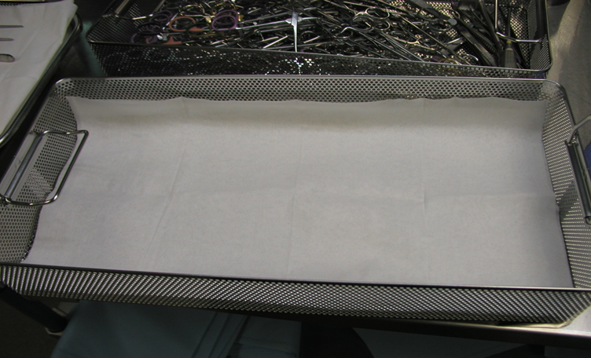
Disposable tray liners are better than using towels!

Slide 51
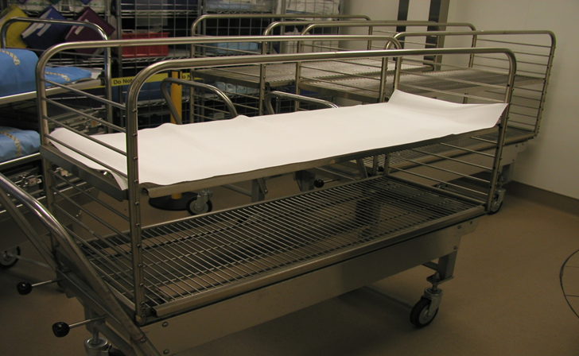
GO TO HEALTHMARK AND USE CREPE PAPER AUTOCLAVE LINER
*Only to be used under wrapped trays, NOT peel pouches or rigid containers

Slide 52
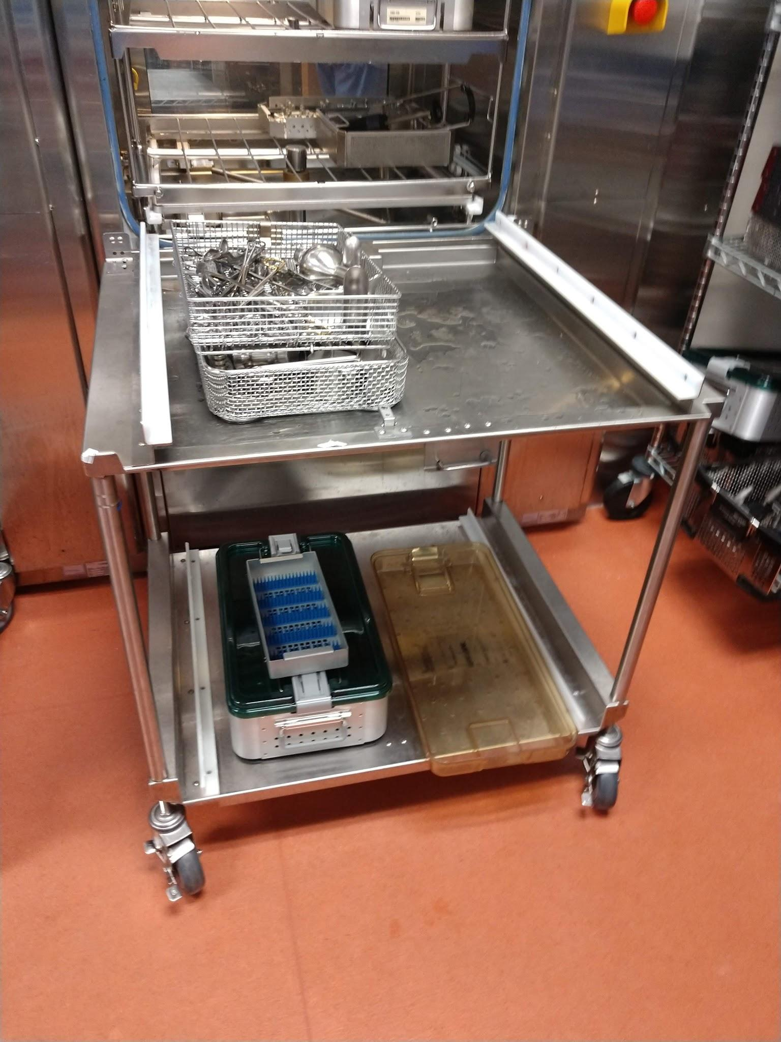
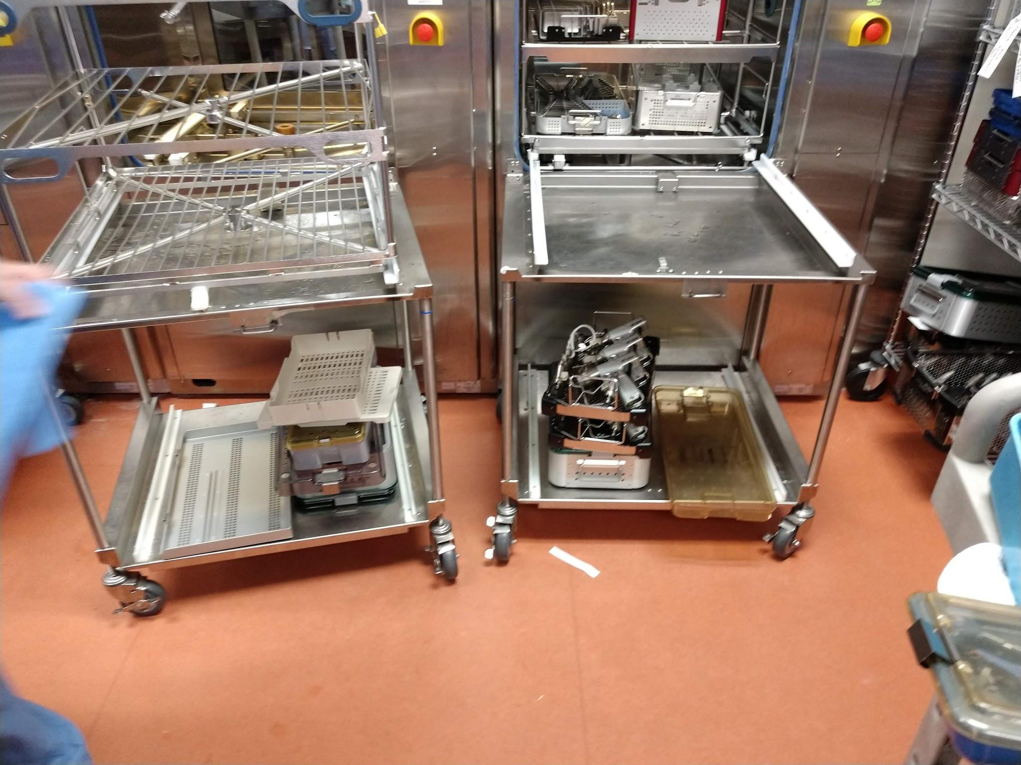
No storage under or directly on washer racks on cleanside. Even if temporary

Slide 53
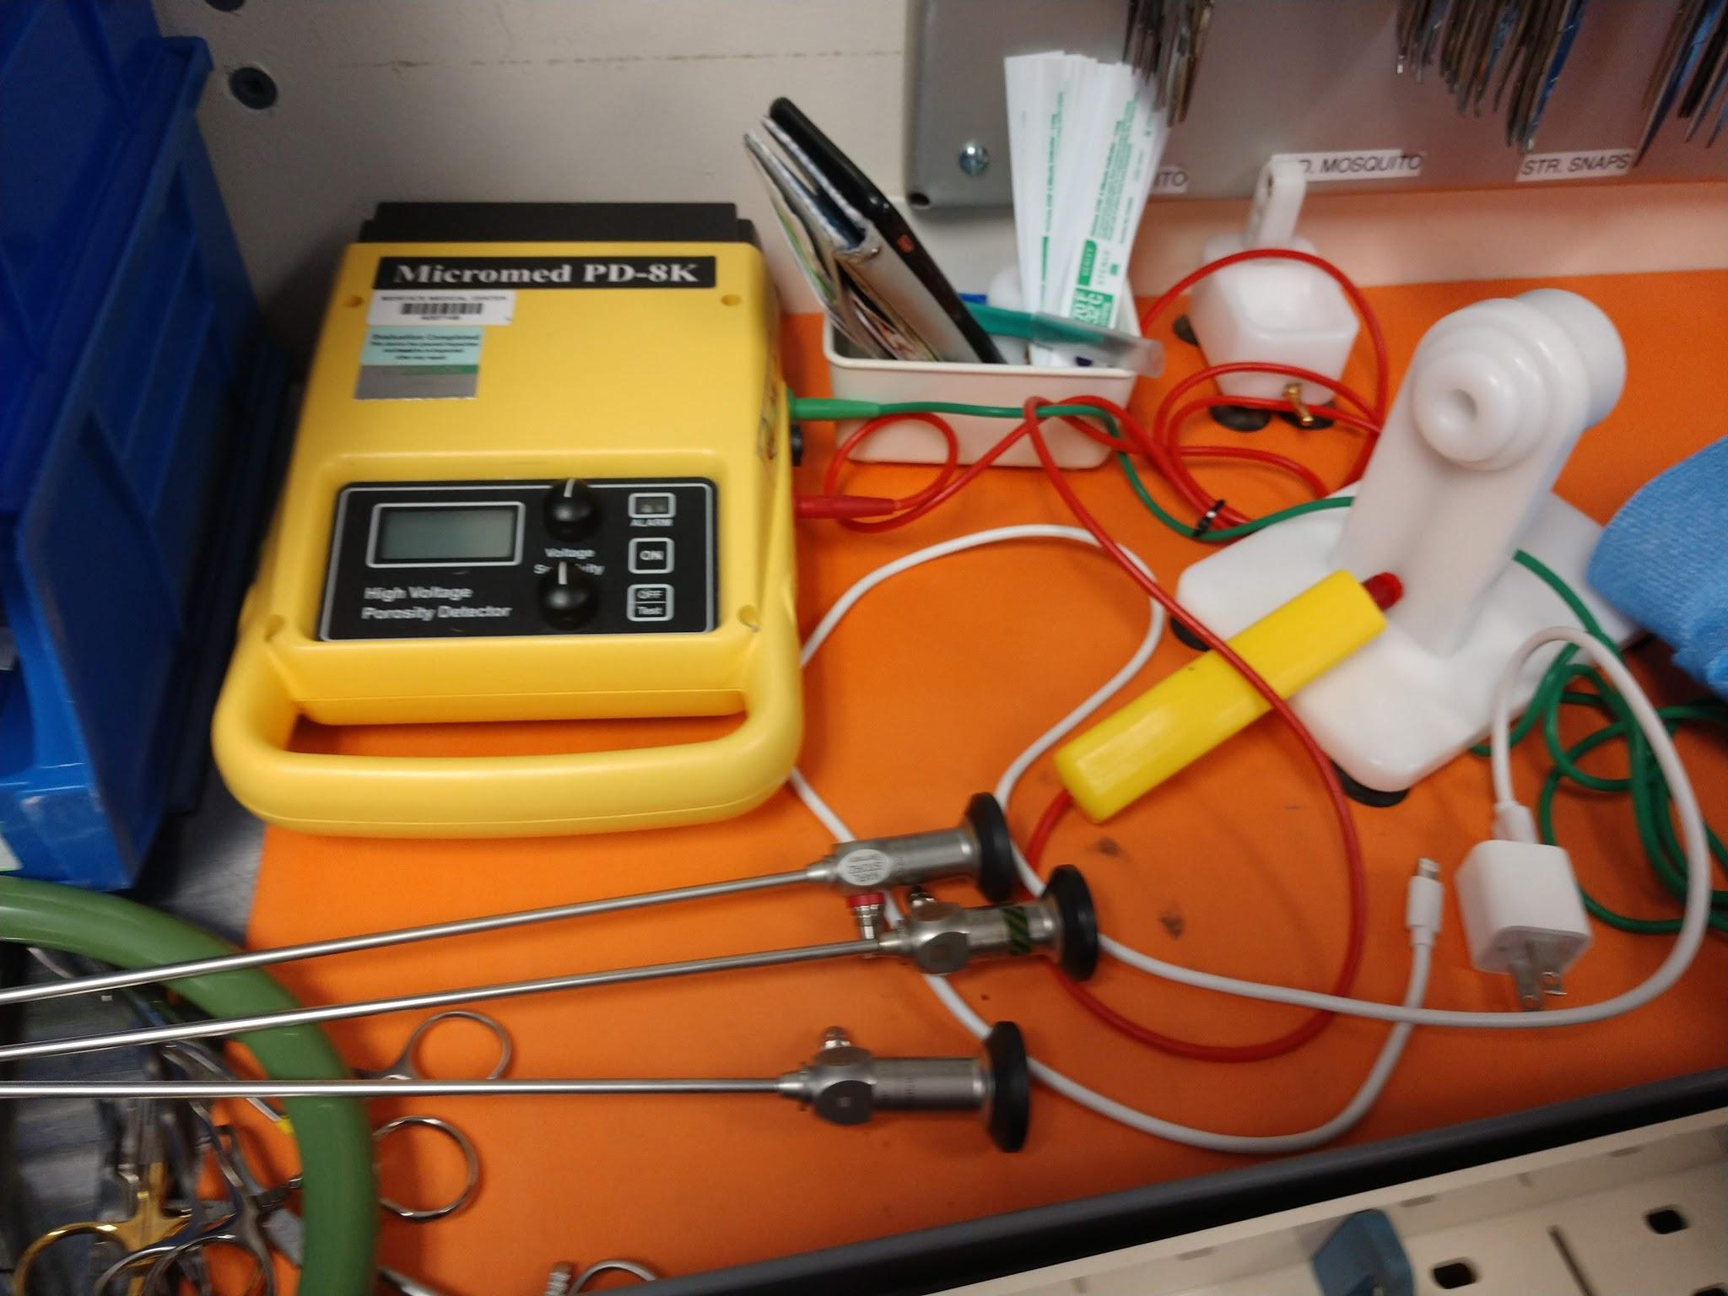
ALL insulated instruments must be inspected with an insulation tester. New AAMI amendments coming

Slide 54
Check IFU

Slide 55
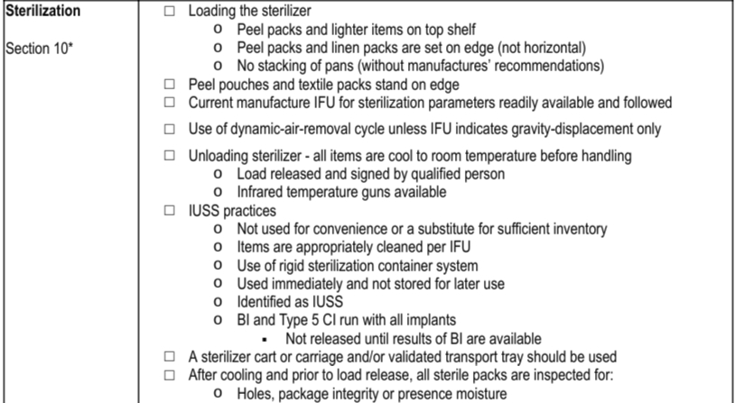
CAN ALMOST BE SEPARATE AUDIT

Slide 56
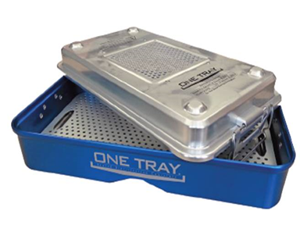
Make sure staff are 100% following exposure cycle times per IFU regardless if it is in a Onetray. Dry time is o (zero) but has nothing to do with exposure. This device is NOT Recalled. Use per IFU. Contact David for more guidance davidjagrosse@gmail.com

Slide 58
AAMI ST:79 2017 Standards and Wrap IFU
AAMI ST70 2017 11.1.1
Positioned so that packaging is not crushed, bent, compressed, or punctured
Wrap manufacturer’s IFU should be consulted for guidance on stacking trays
Open shelving may be used, but requires special attention to traffic control, area ventilation, and environmental services
The bottom shelf of storage carts or shelving should be solid

Slide 59
Review IFU for tray belt. Currently used in CSS for sterilizer cart. Intended purpose is for sterile storage and OR Mishandling
For Storage and external handling
For sterilizer cart

Slide 60
In-servicing on wrapping
Wrap was being done inconsistently and incorrectly
Get Halyard,Cardinal or Medline on-site to do education

Slide 61
Get window coverings for windows in storage area
UV can degrade packaging and contents

Slide 62
Need different storage solution for long peel pouches

Slide 63
Check IFU’s to verify these practices

Slide 64
Wrapped sets should not be stacked on top of rigid containers

Slide 65
Use of Halyard blue trays
stack tray on tray for better protection

Slide 66
Shelving also needs to be reviewed in SPD

Slide 69
Consider Quality management for future. AAMI ST90:2017

Slide 71
AUDITS
Assesment/Audit internal or external person

Slide 72
Hospitals have a capital budget process for approving new devices. Part of that process is a form that needs to be filled out. It is within that form that we have the opportunity to identify devices that require high-level disinfection or sterilization. Change the request form to ask this question and if the box is checked off as yes it should go to the cssd manager to ensure that we have the ability to reprocess the device.

Slide 73
Policies and documented procedures are the most powerfull tool you have for accuracy and consistency within the system. They are also essential when DPH or JCAHO inspections occur. Make sure your polices are current and based on best practice,MFGR IFU and current guidelines.

Slide 74
Process Improvement
Loaner Process
Forecasting → Processing → Staging
Assembly Productivity
T-Processing
Case Processing
Traffic Control
Set up processes now to prevent transfer of current habits created by logistical constraints to new space

Slide 77
CURRENT STATE:
“ISLANDS of Processing”
Duplication of peel pouching,wrap insulation testing etc.
No team work
Cherry Pick sets
Poor work flow
No Quality checks by design.
WRAP
WRAP
ASSEMBLY ISLAND
ASSEMBLY ISLAND
CONTAINER CART
WRAP
WRAP
ASSEMBLY ISLAND
ASSEMBLY ISLAND
Washer output
Washer output
Washer output

Slide 78
Eliminate holding racks by going to “T” processing and new prioritization system and processing by case with tags in decontam.

Slide 79
Cases
4 and 6
Case 5
Cases
1 and 2
Case 3

Slide 84
ALL insulated instruments must be inspected with an insulation tester. New AAMI amendments coming

Slide 86
FUTURE STATE

Slide 87
Make sure your AAMI ST79 is latest version and accessible. 2017

Slide 88
Involvement with state IAHCSMM chapter (CCSA). Staff attend local education conferences for CEU. Hospital reimburse cost of attendance.
Leadership in dept to attend annual IAHCSMM conference for education and networking. Also possible involvement with AAMI ST:79 workgroup
Start Library based out of office of educational books for staff to read and develop.
Free magazines for education/CEU’s. Infection Controol today,Healthcare Purchasing News, IAHCSMM magazine.

Slide 90
Join the Fight
"Those who expect to reap the blessings of freedom must, like men, undergo the fatigue of supporting it." Thomas Paine

Slide 91
Change will not come about through expectation –Dave Jagrosse

Slide 92
THANK YOU!

