Slide 1
Continuous Improvement for Everyday Processing

Slide 2
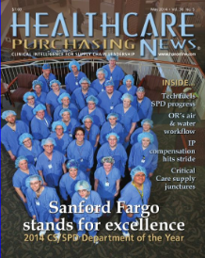
About me
Healthcare Purchasing News 2014 CS/SPD Department of the Year (Sanford Fargo SPD)
IAHCSMM member, CRCST & CHL certifications
Prairie Pioneers (North Dakota chapter) Vice President, 2015 - present
IAHCSMM nominating committee, 2016
AAMI ST79 – Steam Sterilization Practices working group – 2016 - present
AHRMM member
No Coast Consulting, LLC

Slide 3
What is your Why?
Why are you sitting here today?

Slide 4
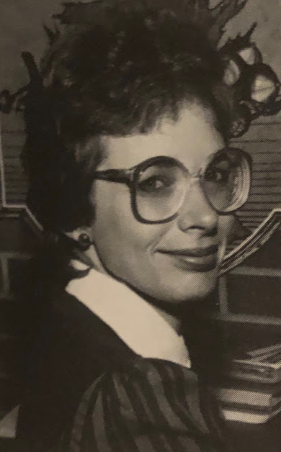
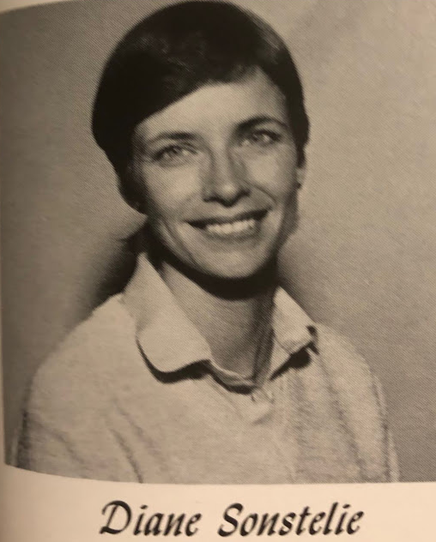
40+ years

Slide 5
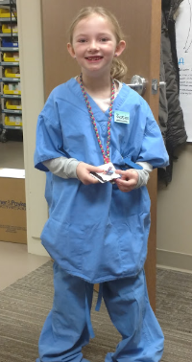
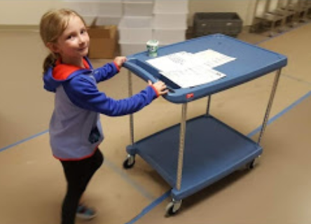

Slide 6
Objectives
Discuss tools to develop a culture of improvement within your department, including
Discuss establishing standard work and training programs
Identify staff-driven improvement projects
Describe methods for delegating project work for technician development

Slide 7
Culture of Continuous Improvement
Improves efficiency and quality
Increases employee engagement

Slide 8
Components - these feed off each other!
Process
Standard work
Process Improvement
People
Employee buy-in
Development and growth

Slide 10
Standard Work & Training

Slide 11
Benefits of Standard Work
Consistent product
Competency is measurable
Reliable base for improvement work

Slide 12
Process and People
The trick is engaging the PEOPLE
“The right process will give you the right results”
You need the right people to get the right process

Slide 13
People will always gravitate towards the easiest path
Don't design processes that make people go out of the way to do the right thing

Slide 14
Where to start?
Process
Analyze current state
Go-see. What is actually happening?
Where is the variation?
People
Find your leaders
May not be “most productive”

Slide 15
Developing Standard Work
Process
Begin writing and formalizing standard processes
People
Employee ownership

Slide 16
Normalized Deviance
Shortcuts and work-arounds
Dangerous - eventually leads to critical errors
Skipping critical tasks
Does everyone understand the importance of each step in the process?
Story telling
“Know Why and Comply”

Slide 17
Base of Standard Work
Process
Develop training manuals
Base off standard work and guides
Consistent Training
Competency Testing
People
Assemble preceptor team
Standard work committee members
Can speak to “why”

Slide 18
Standard Work Committee
Clear ground rules
Review or create standard work templates
Reach consensus
Move forward with one voice

Slide 19
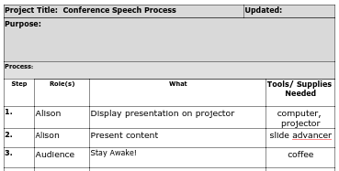
Standard Work Template

Slide 20
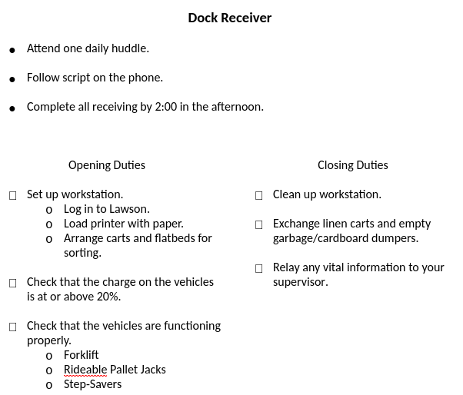
Manual in each area
Ex. opening/Closing checklist
Manual is also included in training manuals

Slide 21
Communicate Expectations
The team needs to know what’s expected of them
Sell vs. Tell
Accountability

Slide 22
Everyday Lean Ideas

Slide 23
What is an ELI?
From Virginia Mason
An Everyday Lean Idea is a staff-driven improvement
Frontline staff are the EXPERTS
Before you start this, you NEED to have standard work in place!
Usually simple

Slide 24
Steps for the ELI
Fill out the ELI form and share with peers
A standard work committee member is assigned as a mentor
Communication plan developed
Idea generator and SWC
Conduct trial
Get feedback
Decide whether to implement

Slide 25
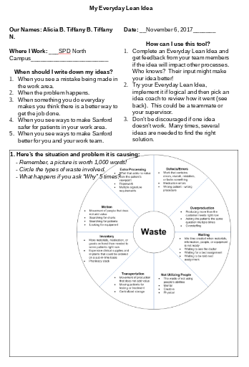
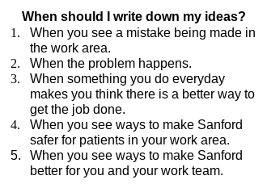

Slide 26
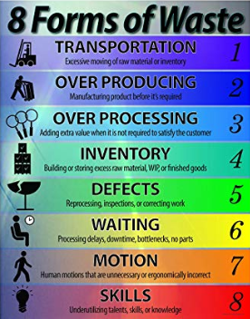
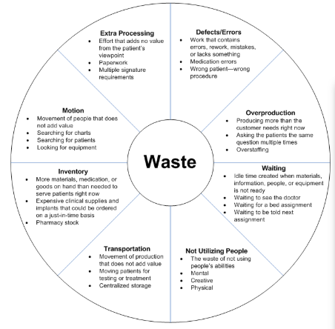
Usually driven by waste
Selected by idea generator

Slide 27
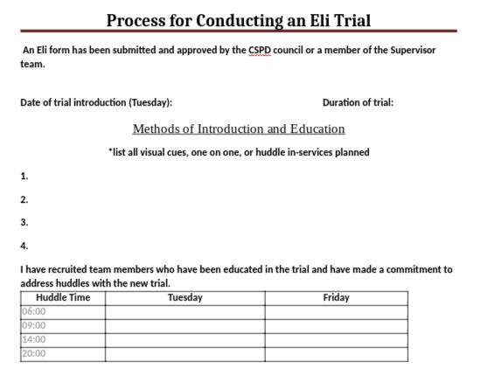

Slide 29
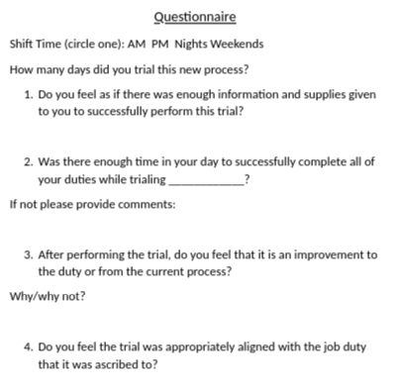
Reviewed during standard work committee meetings

Slide 30
Implementing
This is something that should be celebrated!
Update manuals and standard work documents

Slide 31
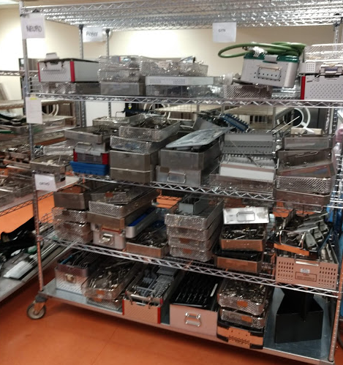
Instrument Assembly
When is this set going to get done???
Cherry picking
Missing instruments
Re-sorting
Verifying priority sets

Slide 32
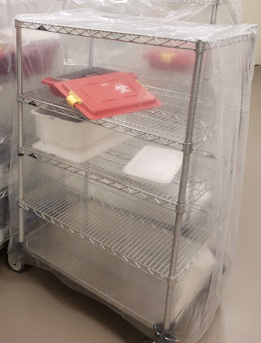
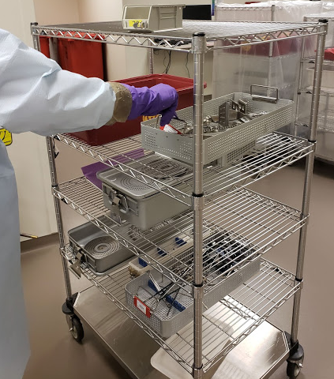
Case Processing
Case is returned to decontam
Decontam tech will assign each set in the case the same number
The first case back from the OR for the day would get a “1” attached to each set
Process the instruments as usual - hand wash or mechanically

Slide 33
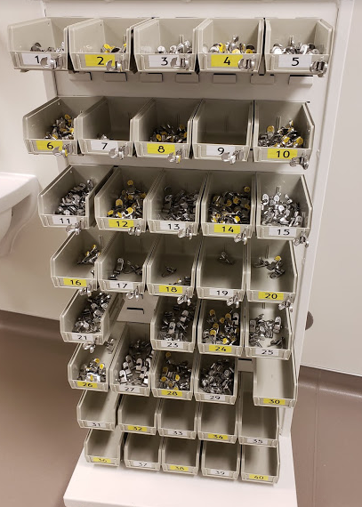
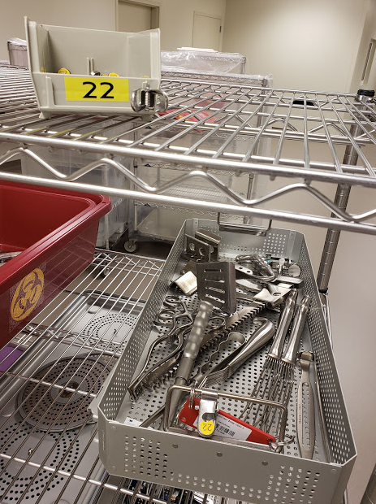
Each set gets a “22” clip

Slide 34
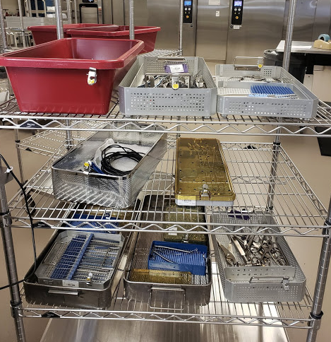
2. An assembly “case cart” is staged
Get rid of the current staging shelving
All sets from the case are grouped together on a cart
Smaller cases can be grouped together on the same cart

Slide 35
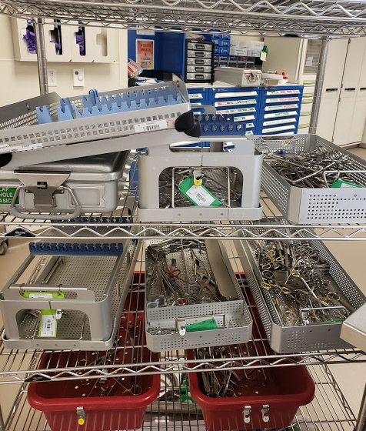
3. Tech assembles every set in that case
Keeps instruments used on that case together
Reduces missing instruments

Slide 36
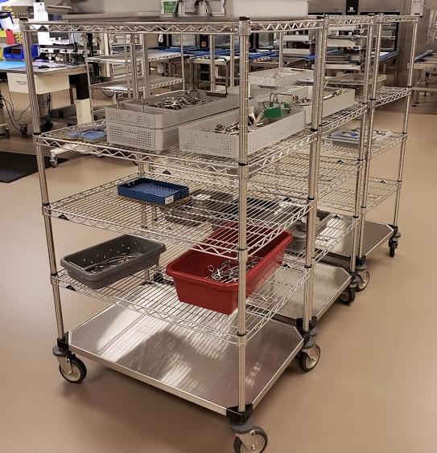
4. Move on to next assembly case cart
Assembly done by FIFO
First in, first out
Use existing method to prioritize turnover instruments or develop one

Slide 37
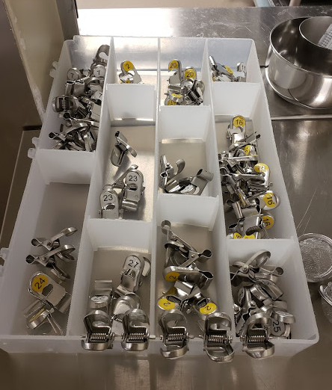
Clips returned to decontam

Slide 38
Results
No cherry picking
Reduced number of missing instruments
Reduced number of leftover instruments

Slide 39
Assigned Project Work

Slide 40
Delegation
Delegating is not always easy
Not just to take work off your plate
Strategy for staff development

Slide 41
Formalizing
Projects are posted on our Project Board
Employees can sign up for projects
Employee is briefed on expectations
We have a project schedule
Time working on project is treated like PTO for coverage of normal duties, employee receives “charge pay”
Feedback form completed after completion
Forms go in employee’s file

Slide 42
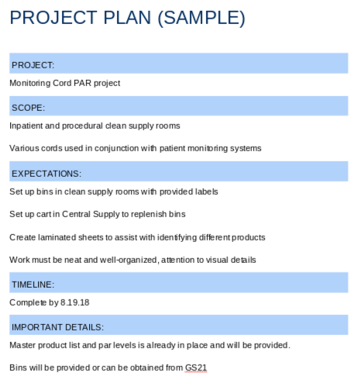

Slide 44
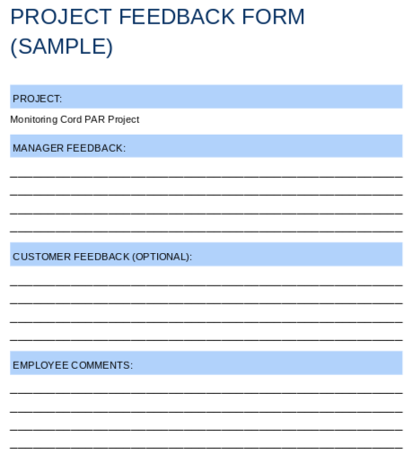

Slide 46
If you are...
A leader
It is your job to develop your team
A tech
You are the expert at what you do each day
If you see a problem, point it out and propose a solution

Slide 47
Developing Partners

Slide 48
Partners
They are the customer, but we are not subservient
Our philosophy is to manage as much as we can
Provide value
Control factor

Slide 49
External Projects
These are usually large scale projects
JIT Case Picking
Equipment Kanban
Soiled Instruments to Decontam

Slide 50
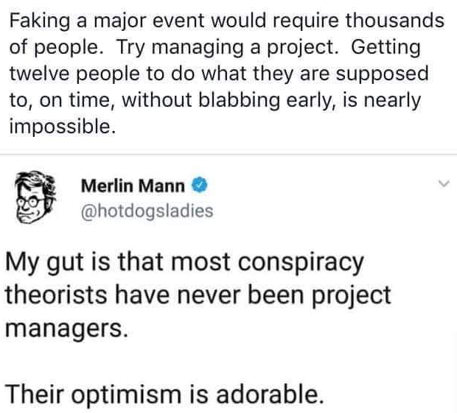

Slide 51
Equipment Kanban
Equipment PAR location on each hospital unit
Was managed by nurses making phone calls - NOT effective
Switched to CS staff doing visual inspection while we were already on unit
Used visual cues to replenish and manage priorities
Eventually switched to RFID management - eliminates visual inspection

Slide 54
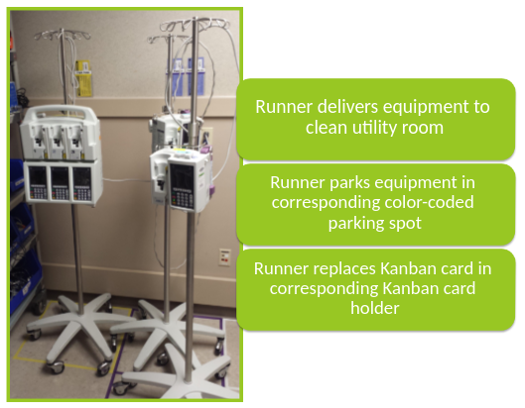

Slide 55
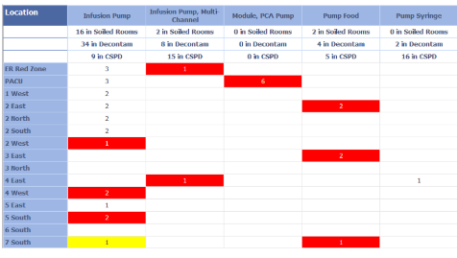

Slide 56
Soiled Instruments
Problems
Not being pre-treated
Overloading containers
Delicate instruments getting damaged

Slide 57
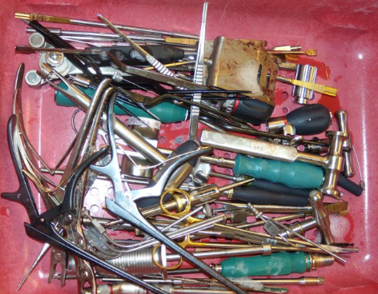
Started with neuro
Documented problems for 2 weeks
PICTURES
Delicate instruments on bottom

Slide 58
Developed standard soiled case cart setup
Added additional items to case cart
Worked with OR educator to create materials for OR training manuals

Slide 59
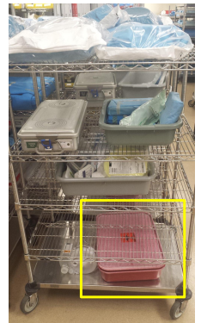

Slide 60
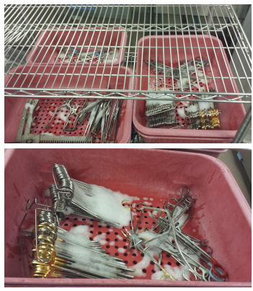

Slide 61
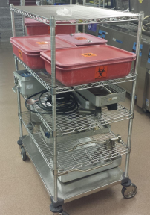

Slide 62
Results
Fewer instruments returned to decontam
Fewer repairs for delicate instruments

Slide 63
You do NOT have to be an industrial engineer or an improvement expert to improve your efficiencies
Engage frontline people
They are the experts!
Celebrate your success

Slide 64
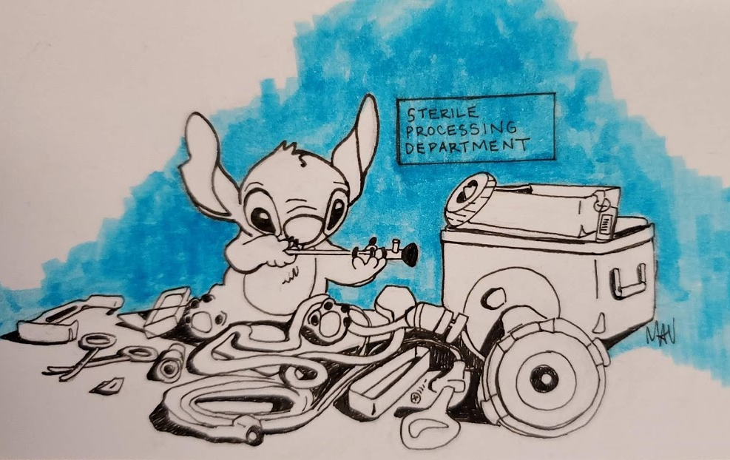

Slide 65
If you’re not part of the solution, you’re part of the problem.
If you’re not part of the problem, then you’re not part of the solution.

Slide 66
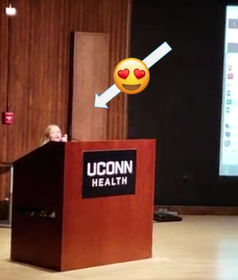
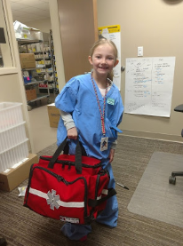
Live your WHY!

Slide 67
Questions?

Slide 68
Bibliography
1. ANSI/AAMI ST79:2017. Comprehensive guide to steam sterilization and sterility assurance in health care facilities. Arlington, VA: Association for the Advancement of Medical Instrumentation.
2. Association of periOperative Registered Nurses. Guideline for manual chemical high-level disinfection. In: Guidelines for Perioperative Practice. Denver, CO: Association of periOperative Registered Nurses, 2018
3. The Toyota Way: 14 Management Principles form the World’s Greatest Manufacturer. Liker, Jeffrey K. McGraw Hill Education, 2004.

